Slide 1
Balance-Getting Rid of the Yoke
“Stand fast therefore in the liberty by which Christ has made us free, and do not be entangled again with a yoke of bondage.” Gal 5:1

Slide 2
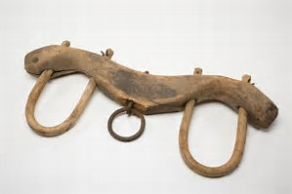
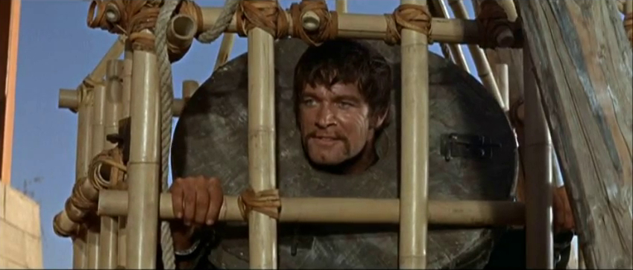
Balance-Getting Rid of the Yoke
Yoke of bondage, as “to make a slave of” or metaphorically to “make myself a bondman.”
“In bondage under the elements of the world”

Slide 3
Balance-Getting Rid of the Yoke
Paul asked, “But now after you have known God, or rather are known by God, how is it that you turn again to the weak and beggarly elements, to which you desire again to be in bondage?” (Galatians 4:9).
Salvation comes by a miracle! By a promise! Nothing a person did in the past, even if that person came from an Israelite heritage, could earn salvation. Nothing a person does in the present can earn salvation.

Slide 4
Balance-Getting Rid of the Yoke
What are some thing that can happen when you are out of balance?

Slide 5
Balance-Getting Rid of the Yoke
“Don’t go back to the worldly ways you practiced prior to being called by God.”
Galatians 5 shows that spiritual liberty comes from knowing the truth.
Be not entangled again with THE ELEMENTS OF THE WORLD.
We are no longer slaves to sin. One way people end back up in slavery is by self-sale. That is, selling oneself voluntarily into slavery.

Slide 6
Balance-Getting Rid of the Yoke
Formerly slaves to sin, Christians are now both "sons“, daughter and "heirs"—and also, in function and responsibilities, as we now serve God.
We can choose to do whatever we want but if we follow God and allow Him to guide us. We can make our way prosperous and have good success.

Slide 7
Balance-Getting Rid of the Yoke
What can get you off of balance. Gal. 5:19-21
Wherefore seeing we also are compassed about with so great a cloud of witnesses, let us lay aside every weight, and the sin which doth so easily beset us, and let us run with patience the race that is set before us." – Hebrews 12:1
This scripture gives the Christian a very practical application for winning the spiritual race that is "set before us", the race of faith which occupies every aspect of our lives.

Slide 8
Balance-Getting Rid of the Yoke
A weight is anything and everything that slows us down from our prescribed run. The expression "every weight" tells us that weights are manifold; there can be many, and they can be diverse but they are sin (ex. Unhealthy friendships/relationships, bad spending habits).
Sin can also entangle or beset us (attack us from all sides) and hinder our movement or growth in Christ.

Slide 9
Balance-Getting Rid of the Yoke
To gain balance you have to let go of some weight.
Again, in Galatians 5, Paul makes the following statement, “For, brethren, ye have been called unto liberty; only use not liberty for an occasion to the flesh, but by love serve one another. For all the law is fulfilled in one word, even in this; Thou shalt love thy neighbor as thyself.”, Galatians 5:13-14.

Slide 10
Balance-Getting Rid of the Yoke
28) Come to Me, all you who labor and are heavy laden, and I will give you rest. (29) Take My yoke upon you and learn from Me, for I am gentle and lowly in heart, and you will find rest for your souls. (30) For My yoke is easy and My burden is light."(Matthew 11:28-30).
God is telling us to take His yoke upon ourselves, learn from Him, experience His way of life, so that we can teach it to others.

Slide 11
Balance-Getting Rid of the Yoke
Be Stand fast- Be firm and unwavering.
We should be firm and unyielding in maintaining the great principles of Christian liberty and not yield to sin again.
Paul said about the matter, “All things are lawful unto me, but all things are not expedient: all things are lawful for me, but I will not be brought under the power of any.”, 1 Cor. 6:12.
Simply stated, Paul says that he can do anything he wants to do, but he avoids things that don’t edify or build or promote his Christian growth.

Slide 12
Balance-Getting Rid of the Yoke
We do have liberty and we can do anything we want to do, but that liberty is to be brought under the power of Jesus Christ.
While we are free to live for the Lord but we still have to follow some rules and regulations of the law if you don’t want consequences (tickets, jail etc.)
We are only free to do those things that build others up, or that do not take away our liberty.

Slide 13
Balance-Getting Rid of the Yoke
Christianity is about a living, vital relationship with the Lord Jesus Christ.
Christianity is an internal matter! It is about “righteousness, peace and joy in the Holy Ghost.” It is a spiritual matter!
The Bible is clear that there are some things that are off limits to the child of God.
However, we need to understand that the don’ts of Christianity are there for our protection.

Slide 14
Next Week
Topic: Free to Help, Not to Hinder
Scripture: Gal. 5:7-18

Slide 15
Resources
Galatians 4-Barnes Commentary
Be Not Entangled-New Testament Baptist Pulpit

