Slide 1
Being God’s Temple pt. 2
Or do you not know that your body is the temple of the Holy Spirit who is in you, whom you have from God, and you are not your own? I Corin. 6:19 (NKJV)

Slide 2
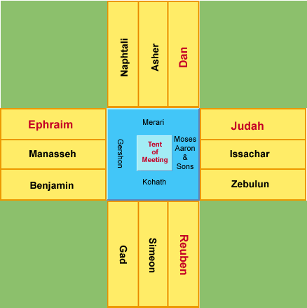
Being God’s Temple pt. 2
Original Tabernacle-The layout was in the shape of a cross. Representing Christ Sacrifice for us.

Slide 3
Being God’s Temple pt. 2
Judah/Issachar/Zebulun-East-Lion-Representing Christ’s Kingship
Ephraim/Benjamin/Manasseh-West-Ox/Calf-Represents Christ’s sacrifice, obedience, humility
Dan/Asher/Napthali-North-Eagle-Represent-Christ coming from heaven to dwell on earth
Reuben/Simeon/Gad-South-Man-Represent-Christ in man form, being a sinless sacrifice for our sins.
Colors of the temple-Purple, Red, Blue, White

Slide 4
Being God’s Temple pt. 2
The Levites-Aaron & his sons, Merari, Kothath, Gershons-sacrificed to take care of the tabernacle.

Slide 5
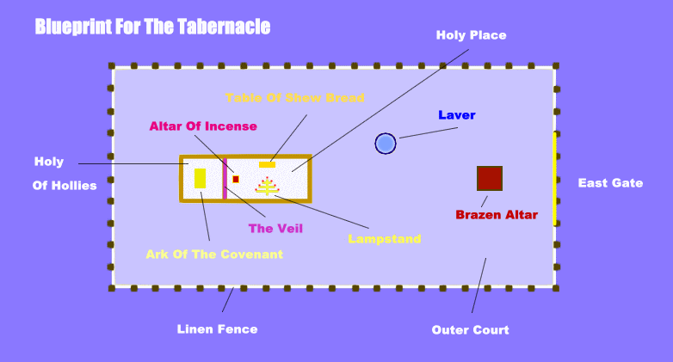
Being God’s Temple pt. 2

Slide 6
Being God’s Temple pt. 2
Now we are God’s Temple:
"I beseech you therefore, brethren, by the mercies of God, that ye present your bodies a living sacrifice, holy acceptable unto God, which is your reasonable service." (Romans 12:2)

Slide 7
Being God’s Temple pt. 2
I am accountable to God for the way I control my body under His authority. Paul said he did not “set aside the grace of God”— make it ineffective (Galatians 2:21).
The grace of God is absolute and limitless, and the work of salvation through Jesus is complete and finished forever.
I am not being saved— I am saved. Salvation is as eternal as God’s throne, but I must put to work or use what God has placed within me. To “work out [my] own salvation” (Philippians 2:12) means that I am responsible for using what He has given me.

Slide 8
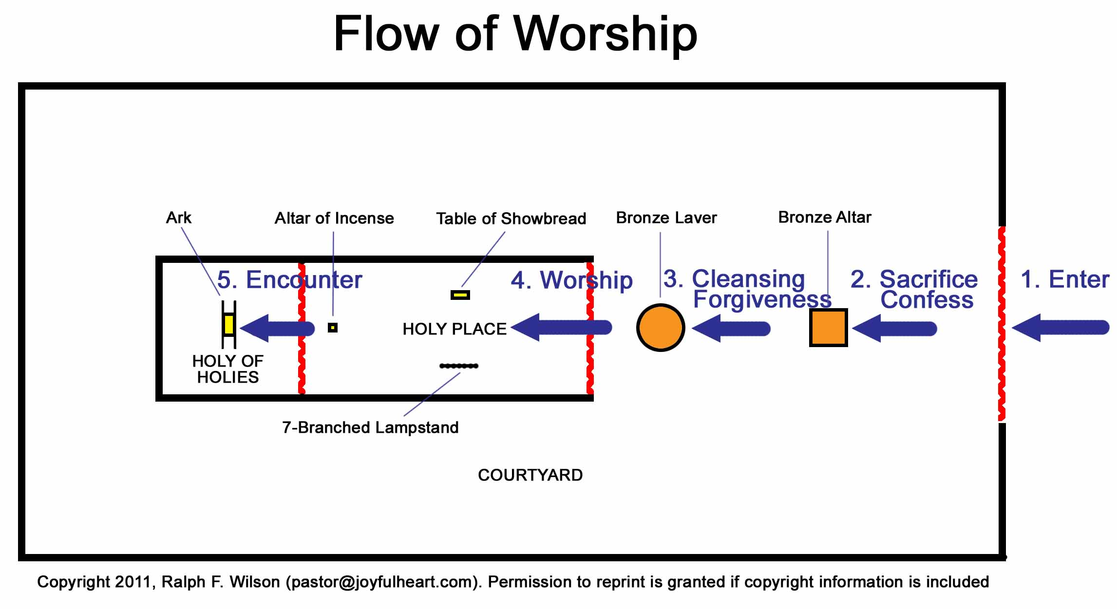
Being God’s Temple pt. 2

Slide 9
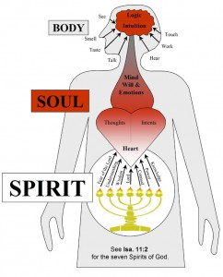
Being God’s Temple

Slide 10
Being God’s Temple pt. 2
The New Testament also says that we are the “temple of God” (1Cor. 3:16) and, just like the temple in Jerusalem, our personal temple is made of three main areas:
Our body, which like the “Outer Court” of the temple is exposed to the world around us and communicates with it;
Our soul, the “Inner Court” where we can exercise our priesthood and responsibility of administering the temple of our life with our choices and decisions;
Our spirit, which like the “Holiest of all” is hidden behind a veil and it’s seldom seen or recognized even by those who are the closest to us.

Slide 11
Being God’s Temple pt. 2
Body-It’s through our physical senses that we communicate with the physical world around us, taking that information and sending it to our mind, where it’s processed with our thoughts.
Spirit-And it’s through our spiritual senses that we also communicate with the spiritual world and, if we are filled with the Holy Spirit, we can commune with the Lord in worship and prayer and be directed by Him if we chose to.

Slide 12
Being God’s Temple pt. 2
Finally, between our “Outer Court” (body) and our “Holiest of all” (spirit), where God’s Spirit dwells and “bears witness with our spirit that we are His children” (Rom. 8:16),
Soul-We have our “Inner Court” (soul), where we’re exercising our freedom of choice, after processing all the information that reaches us through our thoughts and emotions, whether it comes from the physical or spiritual world.
It’s in that dialogue between our heart and mind that we process the information and use our free will to make decisions in life …

Slide 13
Being God’s Temple pt. 2
How Do We Guard our Hearts and our Temple (our bodies) from responding to situations in the wrong way?
Can the world negatively impact us as Christians? How?

Slide 14
Being God’s Temple pt. 2
I discipline my body and bring it into subjection . . .” (1 Corinthians 9:27). Every Christian can have his body under absolute control for God. God has given us the responsibility to rule over all “the temple of the Holy Spirit,” including our thoughts and desires (1 Corinthians 6:19).

Slide 15
Being God’s Temple pt. 2
Most of us are much more severe in our judgment of others than we are in judging ourselves.
We make excuses for things in ourselves, while we condemn things in the lives of others simply because we are not naturally inclined to do them.

Slide 16
Being God’s Temple pt. 2
Paul said, “I beseech you…that you present your bodies a living sacrifice…” (Romans 12:1). What I must decide is whether or not I will agree with God that my body will indeed be His temple.
Once I agree, all the rules, regulations, and requirements of the law concerning the body are summed up for me in this revealed truth-my body is “the temple of the Holy Spirit.”

Slide 17
Being God’s Temple pt. 2
We have to be Gatekeepers Eyes-
I John 2:16-17
Your eye is a lamp that provides light for your body. When your eye is good, your whole body is filled with light. St. Matt. 6:22 (NLT)

Slide 18
Being God’s Temple pt. 2
Gatekeepers Ears-
What we hear- Prov. 2:1-8
Prov. 1:33-But whosoever listens to me will dwell safely, and will be secure, without fear of evil. (NKJV)

Slide 19
Being God’s Temple pt. 2
Gatekeepers
Mouth/Tongue-What we say-James 3:1-12
James 1:26-27- If anyone among you thinks he is religious, and does not bridle his tongue but deceives his own heart, this one’s religion is useless.

Slide 20
Being God’s Temple pt. 2
Gate Keepers
Nose-What we smell- Discerning
Being able to use our senses (smell & taste) to be able to discern what is good or bad for us.
Heb. 5:14-But strong meat belongeth to them that are of full age, even those who by reason of use have their senses exercised to discern both good and evil.
In other words, in order to control our emotions we must be able to tell the difference between good and evil is must exercise or train my senses.
II Corin. 2:14-Now thanks be to God who always lead us to triumph in Christ and through us diffuses the fragrance of His knowledge in every place.

Slide 21
Being God’s Temple pt. 2
Gate Keepers
Nose-What we smell- Discerning
Remember Eve how the enemy made the suggestion “Has God indeed said, you shall not eat of every tree of the garden?
In other words he was trying to get her feelings about the situation. “How do you feel about it?” It’s good for food, pleasant to the eyes and good to make one wise.
If your emotions are out control you will make sense out of why you are right and God is wrong. It’s sensory overload for emotional override! ( by Psuche Soufflé)

Slide 22
Being God’s Temple pt. 2
Gate Keepers-Touch- Watch what we handle-I Corin. 6:12-20
The dilemma with being led by emotions and our senses is that some things that are good for us may not always feel or smell good and some things that are bad for us do ( that large piece of our favorite cake or pie).
We have to learn to not always let our senses (what we smell, taste, feel) control us.
Some of us cry too much. Some of us are mad too often and too long. Some of us have fallen in love too many times with too many of the wrong people, some of us eat too much of the wrong foods.
We have to be able to sense what is good and what may be bad for us.

Slide 23
Being God’s Temple
Gate Keepers
Touch-Watch what we handle-I Corin. 6:12-20
The adversary wants us to void of wisdom and void of good judgment.
He want to put us in sensory overload for emotional override. The song writer of old said "If loving you is wrong, I don’t want to be right". It’s sensory overload

Slide 24
Being God’s Temple
Gate Keepers
Touch-Watch what we handle-I Corin. 6:12-20
Our senses can tell us “It can’t be bad because it feels so good.” “It can’t be wrong because it feels so right.” “It doesn’t feel wrong because I’ve been doing it for so long.”
Flee (run/escape quickly) fornication/sexual immorality (sex outside of marriage)-I Cori. 6:18

Slide 25
Being God’s Temple pt. 2
¹⁰ If you want a happy, good life, keep control of your tongue, and guard your lips from telling lies. ¹¹ Turn away from evil and do good. Try to live in peace even if you must run after it to catch and hold it! ¹² For the Lord is watching his children, listening to their prayers; but the Lord’s face is hard against those who do evil. I Pet. 3:10-12 (TLB)

Slide 26
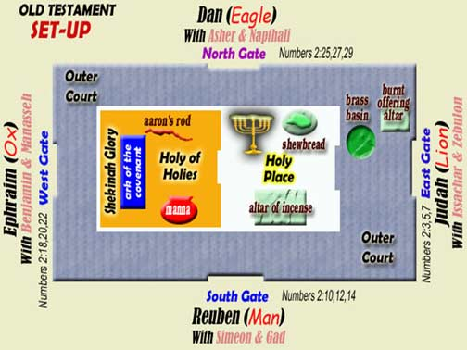
Being God’s Temple pt 2

Slide 27
Next Week’s 4/8/15:
Topic: Hold On To Your Faith
Prov. 4:13
Eph. 6:18
Phil. 2:16
I Thess. 5:21
II Thess. 2:15
I Tim. 1:19

Slide 28
Being God’s Temple
References:
Temple of the Holy Spirit-Oswald Chamber, Dec. 5, 2014
What Does It Mean The Body Is The Temple of the Holy Spirit-GotQuestion.org
Preserve Your Soul…Guard Your Gates-Northminister.online 2/24/2013
Learn to Discernment Good & Evil- Sermon Central/Psuche Soufflé

