Slide 1
Consider the Ants
Go to the ant, you sluggard! Consider her ways and be wise. Prov. 6:6 NKJV

Slide 2
Consider the Ants
What are some things you know about ants?

Slide 3
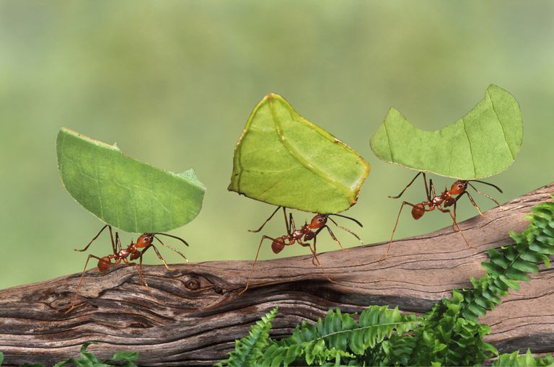
Consider the Ant

Slide 4
Consider the Ants
Ants
An ant brain has about 250 000 brain cells.
A human brain has 10,000 million so a colony of 40,000 ants has collectively the same size brain as a human.
Ants can lift 20 times their own body weight
The abdomen of the ant contains two stomachs.
Each colony of ants has its own smell.
Everyone among them has a definite job to do.
The ant has two eyes, each eye is made of many smaller eyes

Slide 5
Consider the Ants
Ants Teach Us A Lesson About Performance.
The ant has two eyes, each eye is made of many smaller eyes. They have a wide open view of their world.
Likewise we are to have vision committed to preaching, teaching and living the principles of Jesus Christ.
To perform with efficiency there must be a plan.
At first glance at a anthill, and you just see a lot of activity. Ants running around everywhere…..but they have a plan.
As believers who are active in programs/events, if we have no vision for the future.

Slide 6
Consider the Ants
What is our function?
Which way are you going?
As a church we must have a vision/mission, we must be as wise as ants.
We must make all that we do count for the kingdom.
Every part of the organization, every committee, every class within the church should be geared towards reaching and teaching people on practical Christian living in Jesus Christ.
Study to show yourself approved, a workman that is not ashamed……..
The ants know their vision/mission-”Provides her food in the summer and gathers her supplies in the harvest time".

Slide 7
Consider the Ants
Ants Teach Us A Lesson About Performance.
Every ant has a definite job to do and does it.
Take a look at a anthill, and you want see many if any ants just sitting around or standing around doing nothing. Everyone one of those ants have a job, and no one has to tell them what it is…..and no one has to push them to do it.
We are all members of the body with a specific function. We at times put little if any time or planning into our efforts.
Ants work in harmony. They accomplished despite their size and in such a small amount of time is because of harmony.
When those who are called to fish (fishers of men), don’t fish, they fight.
We as believers we are co-laborers with the Lord. We have to work together, and pull together or we’ll pull apart!

Slide 8
Consider the Ants
Scripture that talk about developing unity/harmony with others to do the work.
Ecc. 9:10 Whatsoever thy hand findeth to do, do it with thy might........."
Col. 3:17 And whatsoever ye do in word or deed, do all in the name of the Lord Jesus.
Col 3:21 And whatsoever ye do, do it heartily, as to the Lord, and not unto men;
Ps. 133:1 Behold how good and how pleasant it is for brethren to dwell together in unity!
Eph 4:3 Endeavoring to keep the unity of the Spirit in the bond of peace.

Slide 9
Consider the Ants
Ants Teach Us A Lesson About Preparedness
An ant brain has about 250 000 brain cells.
Ants don’t know the meaning of procrastination ! They don’t wait until the weather turns cold before they are preparing. They gather food while it is still warm and take it into their colony !
It is good common sense, and stewardship to prepare for the future.
Is there something God has told you to do or the Holy Spirit is leading you to do….and yet you’ve put it off ? Do it now . Prepare now .

Slide 10
Consider the Ants
The Ants Teach Us A Lesson About Perseverance
Ants can lift 20 times their own body weight
Proverbs 30:25 The ants are a people not strong, yet they prepare their meat in the summer. They prepare for their family.
Ants aren’t quitters. They persevere even through danger.
You can run over a anthill with a lawn mower……kick it in…..wash it away with a water hose…..and they’ll build it back.
If we faint in the day of adversity our strength is small.
We can do ALL things through Christ that strengthens us.

Slide 11
Consider the Ants
The Ants Teach Us A Lesson About Fellowship
The abdomen of the ant contains two stomachs
One stomach holds the food for itself and second stomach is for food to be shared with other ants.
During their growth stage, the immature ants are fed, cleaned and attended by adult workers.
Mature Christians should feed the word to young Christians so that they can grow.
God gives us the ability to carry each others burdens. Gal. 6:2

Slide 12
Consider the Ants
The Ants Teach Us A Lesson About Discernment
Each colony of ants has its own smell.
They fight intruders to protect themselves, the young and their homes.
God has given us the spirit of discernment
1 Corin. 2:14 says; "But the natural man receives not the things of the spirit of God: for they are foolish unto him: neither can he know them because they are spiritually discerned.
But he that is spiritual judges all things, yet he himself is judged by no man. For who has known the mind of the Lord, that He may instruct him? But we have the mind of Christ".

Slide 13
Consider the Ants
God often compares us to the best of His creation to teach us principles for a victorious life.
It takes hard work and determination to be like the ant.
Let us learn from this little creature to put to use all of our abilities so that we can be instrumental in God’s kingdom.
Let us not forget the Mission and Vision that God has given us so we can prosper as we do the work of God.
Each person is responsible to what we have been called to do.

Slide 14
Next Week Bible Study
TBA

Slide 15
Resource
You Can Learn from Ants-Mike Turner 2004

