Slide 1
Tracey Hickmon Rebuilding Coordinator Healthy Christians
Abiding Faith Christian Church
9-28-16

Slide 2
Objectives
Mood check
Increase awareness of DV
Think about proactive and reactive responses to DV
Individual
Church

Slide 3
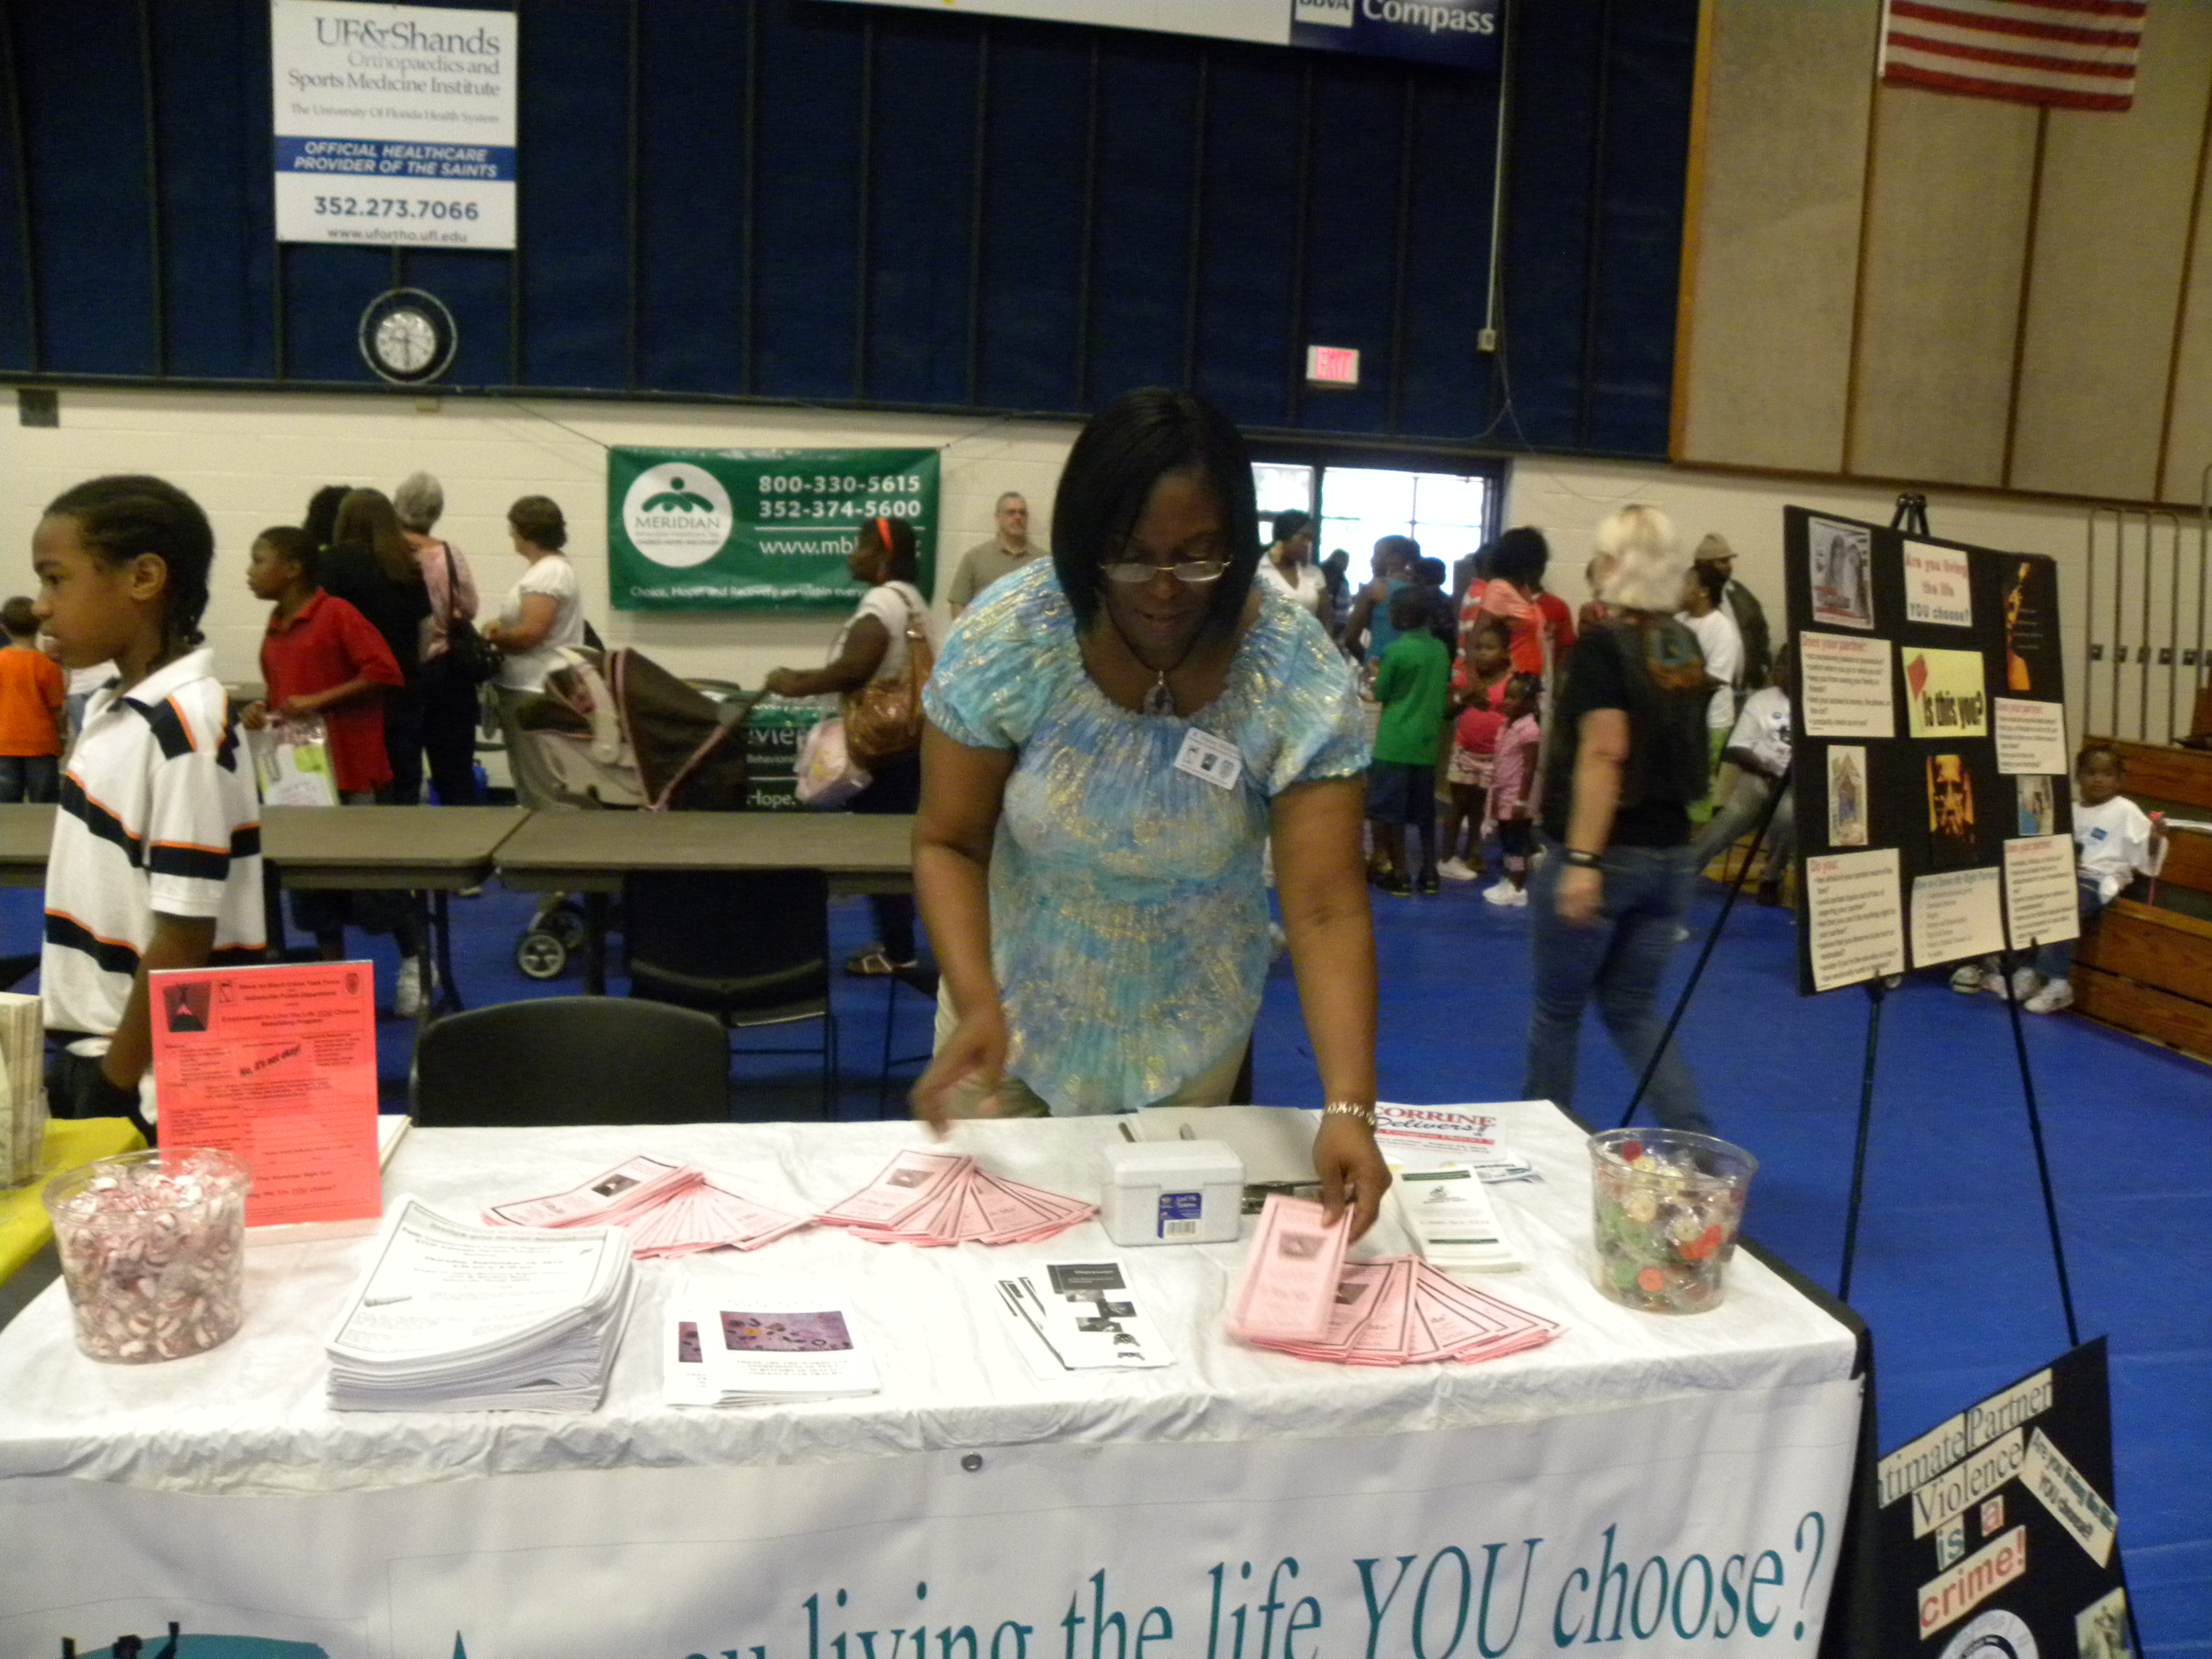
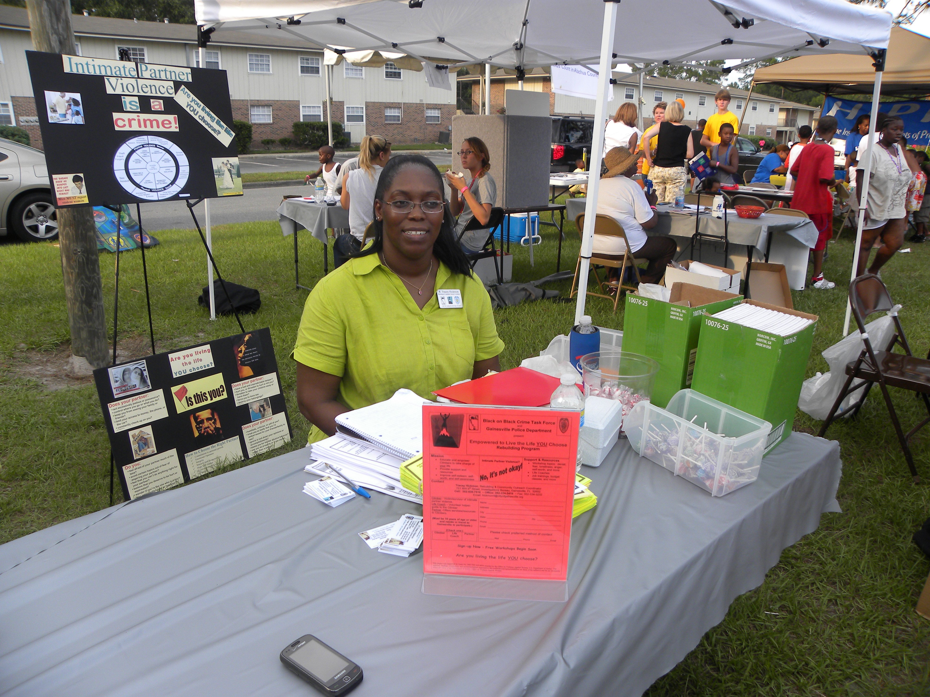
"Are YOU living the life you choose?"
Empowered to Live the Life YOU Choose Rebuilding Program

Slide 5
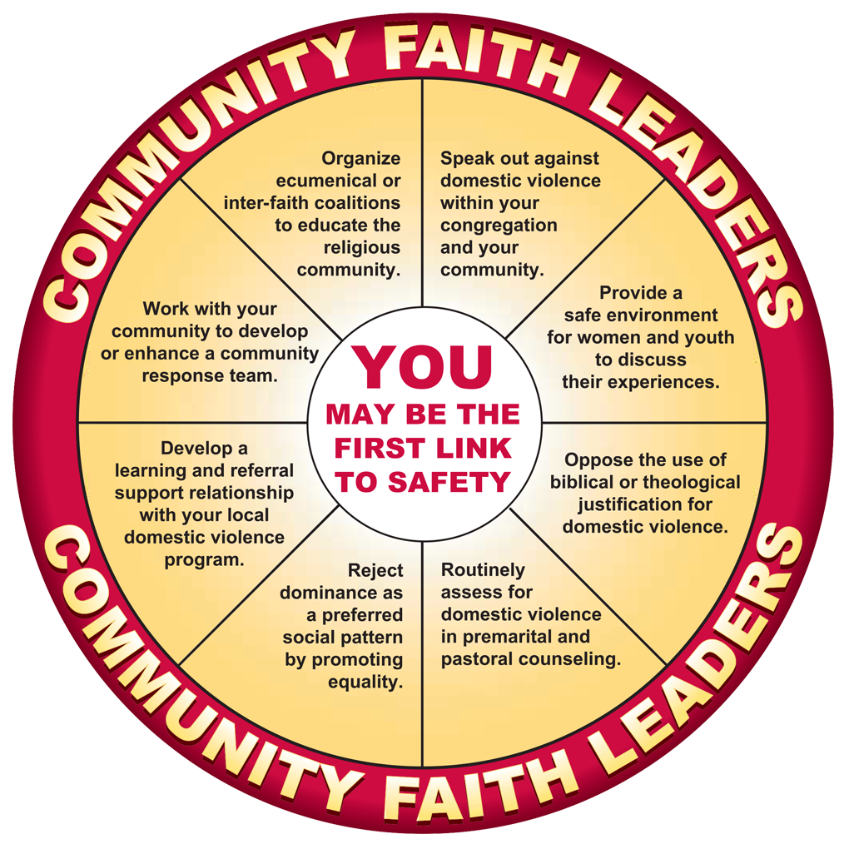
Faith Communities Coming Together to Stop Intimate Partner Violence ~
"Strengthening Families Seminar"
Host Church needed for October, November and 2017

Slide 6
Believe It or Not?
Going to a substance abuse program will stop intimate partner violence.

Slide 7
NOT!

Slide 8
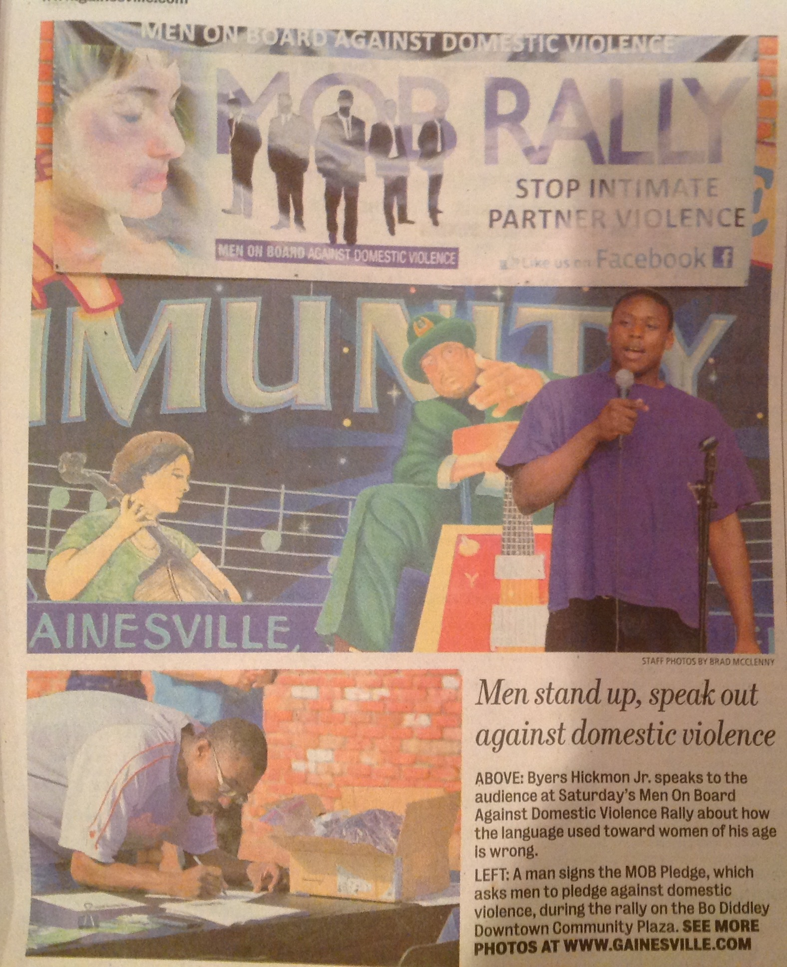
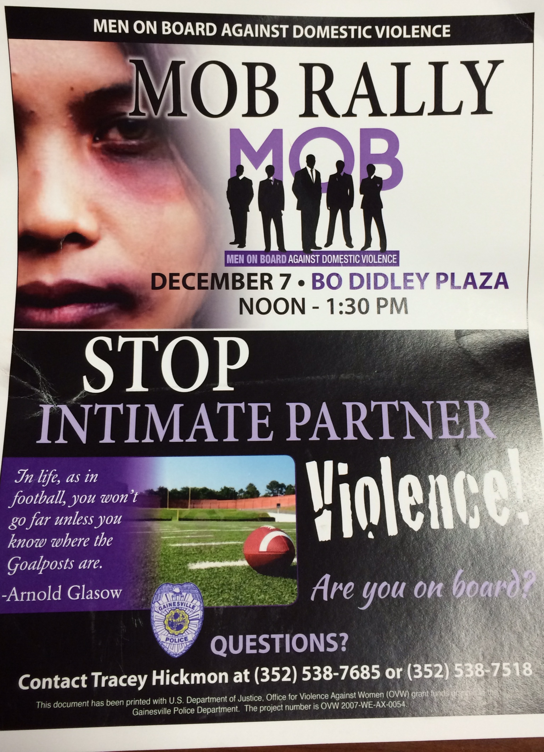

Slide 9
Believe It or Not?
Every 9 seconds a woman is assaulted or beaten by intimate male partners.

Slide 10
Believe It
Capuzzi, D. & Gross, D.R. (2014). Youth at Risk: A Prevention resource for Counselors, Teachers, and Parents (6th Ed.). P. 24. Alexandria, VA: American Counseling Association

Slide 11
Ephesians 6:12
We are engaged in a mammoth spiritual struggle, one that puts us "against the rulers, against the authorities, against the power of this dark world and against the spiritual forces of evil in the heavenly realms.
Satan's Strategy: keep us weak, alone, and in pain, so we would lack the focus and energy to search for God.
McKinney, G.D. (2005). The New Slavemasters, pp. 15-16, Colorado Springs, CO: Cook Communications Ministries

Slide 12
Satan's Goal... Keep us ALONE, WEAK AND IN PAIN
John 10:10-
... The comes except but for the steal kill and to destroy.
Ephesians 6:4-
Fathers, do not provoke your children to anger, but bring them up in the discipline and instruction of the Lord.
Satan would like to see those tender moments of training and instruction change into angry, violent, polarizing confrontations.
McKinney, G.D. (2005). The New Slavemasters, pp. 16, Colorado Springs, CO: Cook Communications Ministries

Slide 13
The New Slavemasters
Drugs
Materialism
Mindless pursuit of pleasure
Racism
Teen pregnancy
Domestic violence
Adult & child pornography
Overpowering
Step-directing rage
McKinney, G.D. (2005). The New Slavemasters, pp. 16, Colorado Springs, CO: Cook Communications Ministries

Slide 14
Statistics
In 2013 GPD reported...
338 AAF, 238 WF, 150 AAM & 85 WM who were victims of domestic violence out of a total of 800 reported documented incidences. Therefore, 61% of DV victims are AAF.
In 2014 GPD reported...
408 AAF, 233 WF, 147 AAM, 95 WM who were victims of domestic violence out of 889 reported documented incidences. Therefore 62% of DV victims are AAF.
National Average of AA victims is 4/10 or 40% in 2010 National Intimate Partner & Sexual Violence Survey by the Center for Disease Control.
AA F in Gainesville are slightly above national average by 2% in 2013 and 6% in 2014.

Slide 15
In Gainesville
23% population Gainesville - Black/AA
63% of IPV victims

Slide 16
Believe It or Not?
Nearly 50 people per minute are physically abused by an intimate partner in the United States.

Slide 17
NOT
20 people
National Coalition Against Domestic Violence

Slide 18
Domestic Violence
Florida Statute 741.23
(2) "Domestic violence" means any assault, aggravated assault, battery, aggravated battery, sexual assault, sexual battery, stalking, aggravated stalking, kidnapping, false imprisonment, or any criminal offense resulting in physical injury or death of one family or household member by another family or household member.
(3) "Family or household member" means spouses, former spouses, persons related by blood or marriage, persons who are presently residing together as if a family or who have resided together in the past as if a family, and persons who are parents of a child in common regardless of whether they have been married. With the exception of persons who have a child in common, the family or household members must be currently residing or have in the past resided together in the same single dwelling unit.

Slide 19
Power and Control

Slide 20
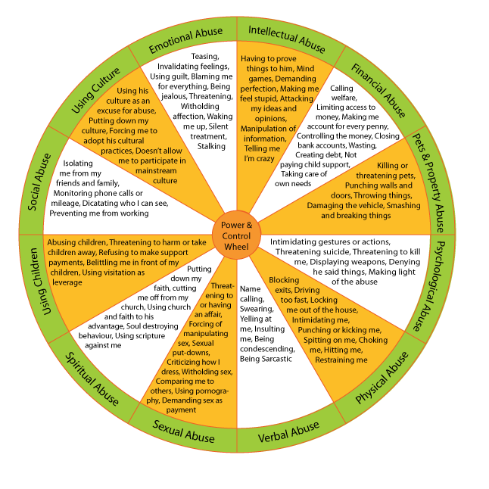
"Intimate partner violence" describes physical, sexual, or psychological harm by a current or former partner or spouse.
~ CDC & Prevention

Slide 21
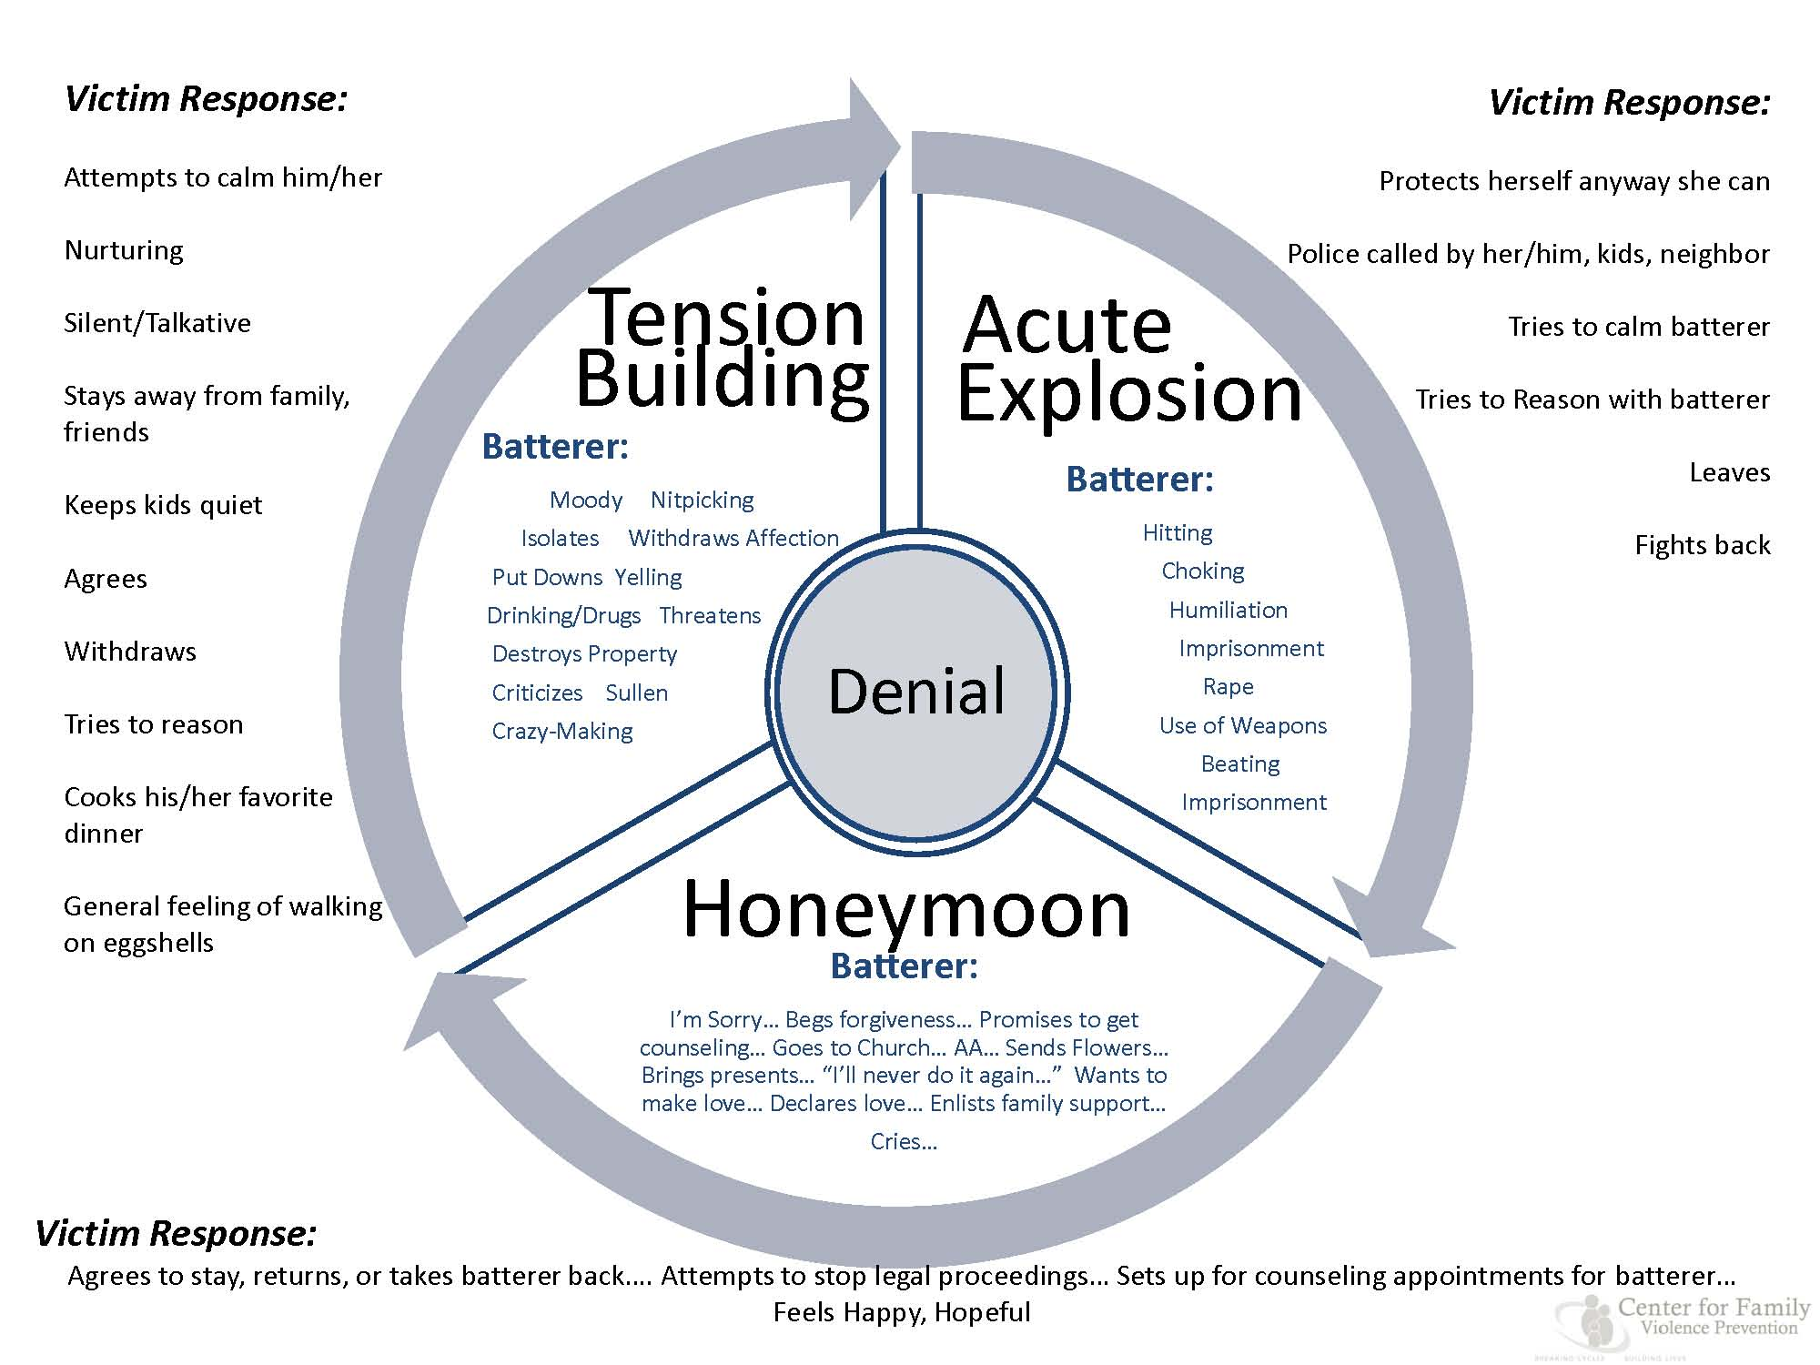

Slide 22
3 reasons why males commit violence against women and girls
It works! An abuser's actions have a purpose: stopping whatever behavior threatens his "authority." An abuser chooses to use violence to get a woman to do something or to get a woman to stop doing something.
They can! Most men know that they can overpower ... a woman with few consequences. For millennia, male abuse of women has been validated by sexist norms.
They learn to! Men have been taught that aggression is a natural part of being a man. Culture teaches that men are superior to women and that superiority gives them the right to I use aggression to dominate and control women. ~ Men Stopping Violence

Slide 23
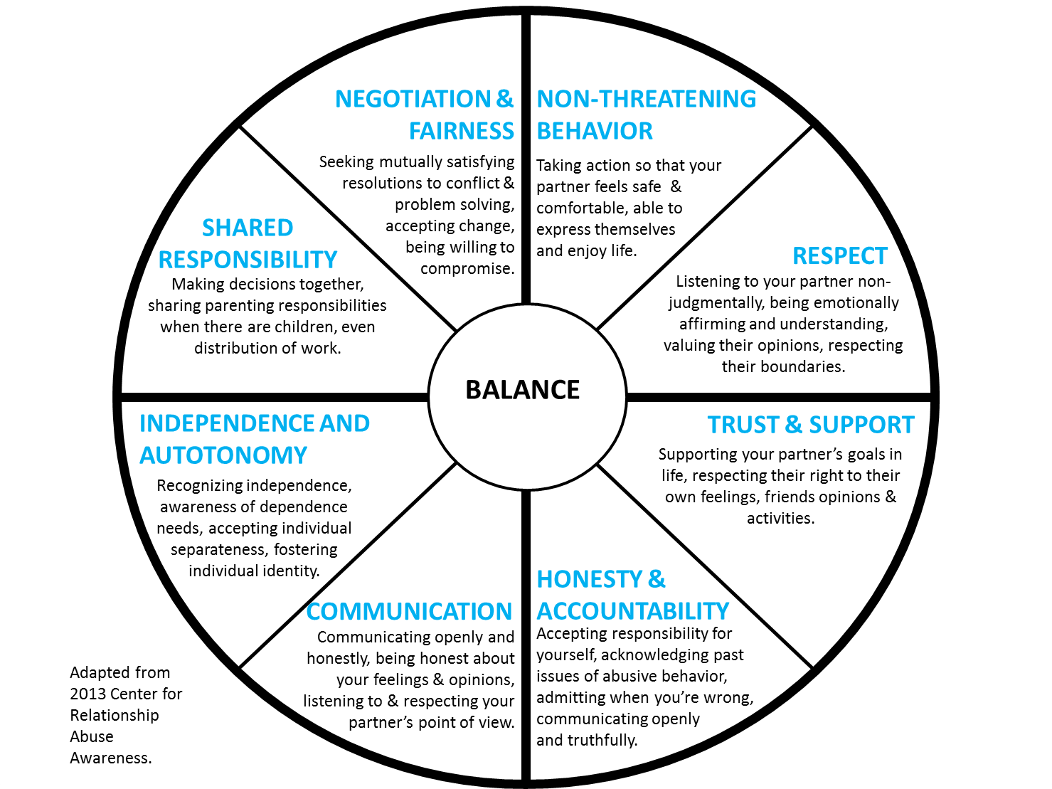

Slide 24
Believe It or Not?
40 – 54% of women KILLED in the US are KILLED by their HUSBAND, BOYFRIEND OR EX.

Slide 25
Believe It!
Jacquelyn Campbell PhD RN FAAN
Johns Hopkins University School of Nursing
Multi City Intimate Partner Femicide Study

Slide 26
Trauma
An injury [physical, emotional, psychological and/or spiritual] caused by an outside, usually violent, force, event or experience.
Upsets equilibrium and sense of well-being.
Distorts attitudes and beliefs.
Distortions result in dysfunctional behaviours which can produce unwanted consequences.
Think about repeated traumas...

Slide 27
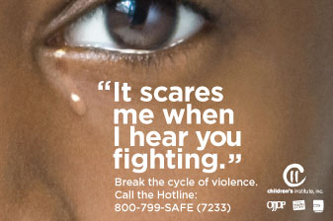
Children
Studies suggest 10 million annually witness some form of domestic violence.
Training the next generation (victims/perpetrators)
Display a higher number of somatic, psychological and behavioural problems than children who have not witnessed intimate parent violence.
Capuzzi, D. & Gross, D.R. (2014). Youth at Risk: A Prevention resource for Counselors, Teachers, and Parents (6th Ed.). P. 24. Alexandria, VA: American Counseling Association
Lawson D.M. (2013). Family Violence: Explanations and Evidence-Based Clinical Practice, 53. Alexandria, VA: American Counseling Association

Slide 28
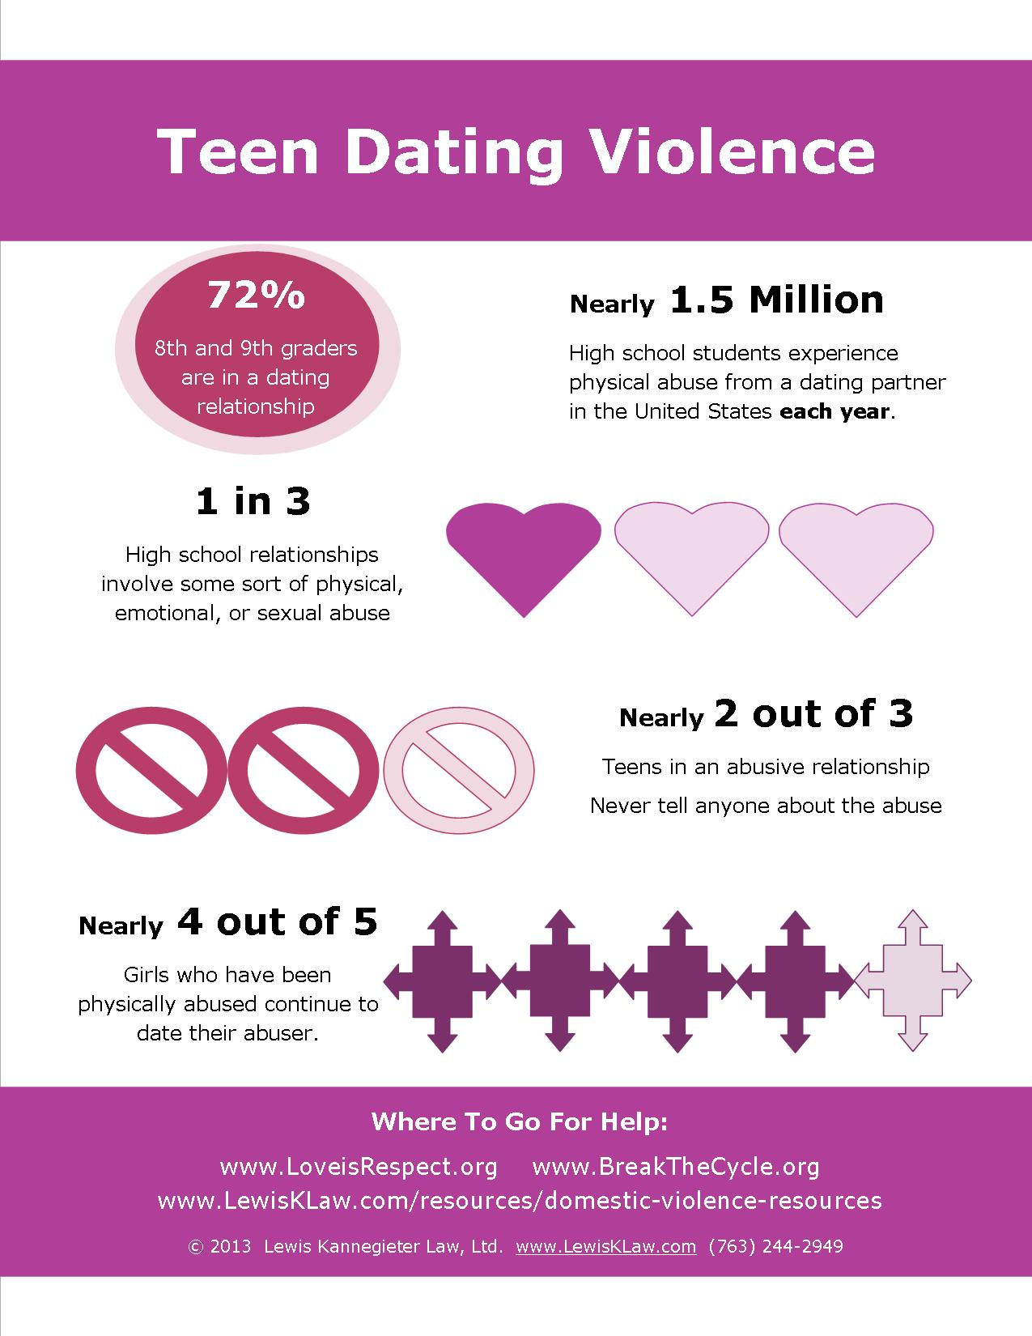
Teens
Nearly one in five teenage girls who have been in a relationship said a boyfriend threatened violence or self-harm if presented with breakup.
Capuzzi, D. & Gross, D.R. (2014). Youth at Risk: A Prevention resource for Counselors, Teachers, and Parents (6th Ed.). P. 24. Alexandria, VA: American Counseling Association

Slide 29
Parenting
Teens
Adolescent domestic violence charges
Child abuse
Don't take it personal
Little adult assumption

Slide 31
Single Mothers
Plight ... extraordinarily stressed, facing insurmountable problems associated with single parenting ... poverty, lack of extended family support, lack of affordable childcare available during work hours, and homelessness.
63% have been violently abuse by an intimate male partner
Capuzzi, D. & Gross, D.R. (2014). Youth at Risk: A Prevention resource for Counselors, Teachers, and Parents (6th Ed.). P. 412. Alexandria, VA: American Counseling Association

Slide 32
Believe It or Not?
5 – 8% of MEN are KILLED by their WIFE, GIRLFRIEND OR EX.
Jacquelyn Campbell PhD RN FAAN
Johns Hopkins University School of Nursing
Multi City Intimate Partner Femicide Study

Slide 33
Believe It!
Jacquelyn Campbell PhD RN FAAN
Johns Hopkins University School of Nursing
Multi City Intimate Partner Femicide Study

Slide 34
Men as Victims
Tend to underreport
Women's Motivations
Self Defense
Coercion
Anger
Attempts to punish partner for misbehavior
Demand for attention
Retaliation/Punishment especially for infidelity
Women are 2 to 5 times more likely to be injured than men.

Slide 35
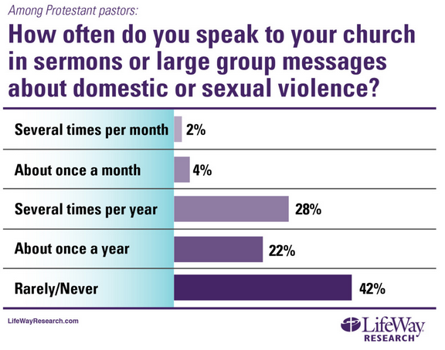
The Church

Slide 36
The Church
Recognize dangerousness
Healing
Response to disclosure in your church
Couples counseling
Insurance and Liability
What can the church do?
Create a safe haven
Develop protocols to help DV victims
Support children
Use your prophetic voice
Work as a team
Educate your community
Teach through life cycle events
Get training

Slide 37
Consider this...
October is Domestic Violence Awareness Month
Preach-In
MOB Rally tentative... GPD ... October 29
Domestic Violence Culturally Sensitive and Faithbased Seminar
Save the date...January 12-13, 2017
Green Dot Trainings (minimum of 20 participants)
Reactive (Direct, Delegate, Distract) bystander
Proactive bystander

Slide 38
Check-In
Mood?
I learned a little.
I learned some things.
I learned a lot!

