Slide 1
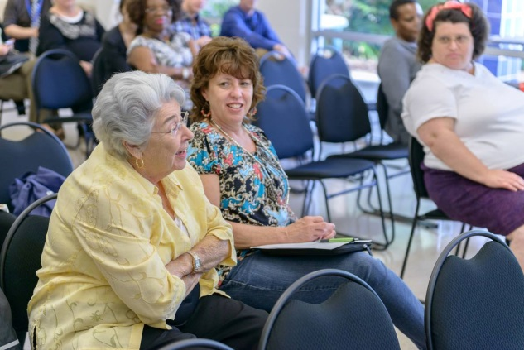
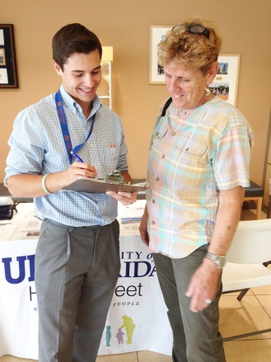
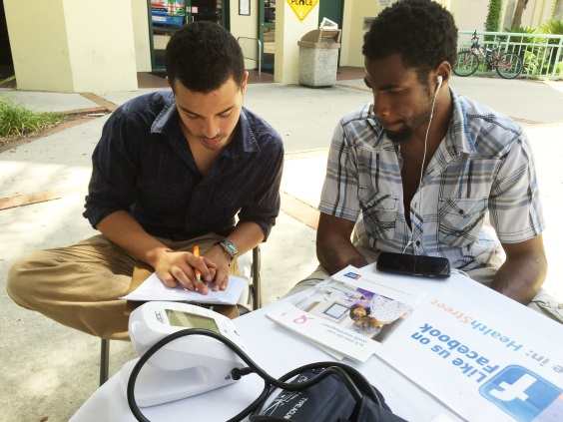
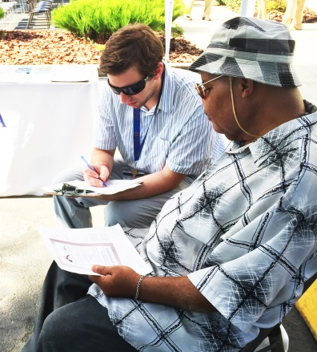
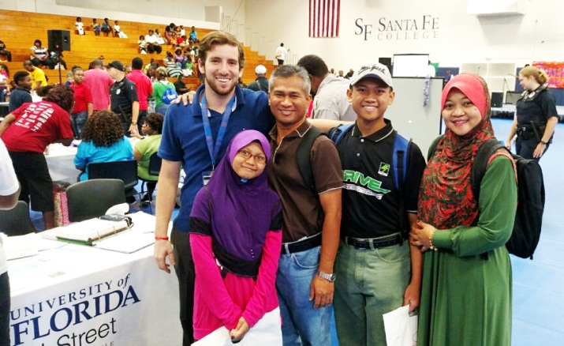
HealthStreet
Research Helping People
Department of Epidemiology

Slide 2
Is Your Voice Being Heard?
More than 80,000 research studies are conducted each year in the United States, yet less than 2 percent of the population participates.
Notes:
Imagine that everyone in this room represents the total population available to participate in a research study! If I could have you raise your hand (politely ask the person to lift their hand).
This one person represents the 1% of everyone who will have their voice heard in research. We’ll understand why this is an issue next.

Slide 3
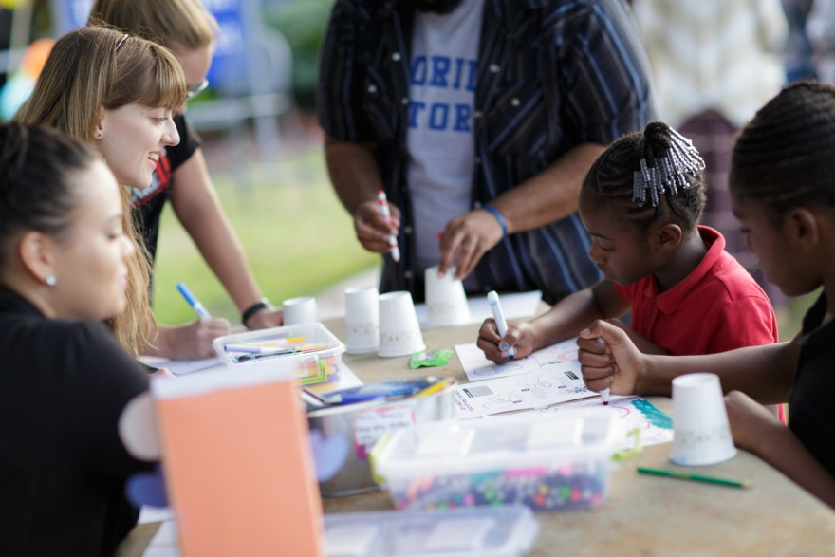
What Is The Problem?
Many populations are underrepresented in research.
Women
Older adults
Racial and ethnic minorities
Those living in rural areas
Leading to research findings that are not representative of all.
That’s why HealthStreet was created: It is important that studies account for these differences to make research findings a reflection of our diverse community.
Notes:
We are trying make research more representative. If we focus on a specific population, how do we know it will work for you. Ex. Depression – Many studies exclude those that have depression. If 1 in 5 people have depression, how can you say that a research study can apply to all people when such a prevalent condition is excluded.

Slide 4
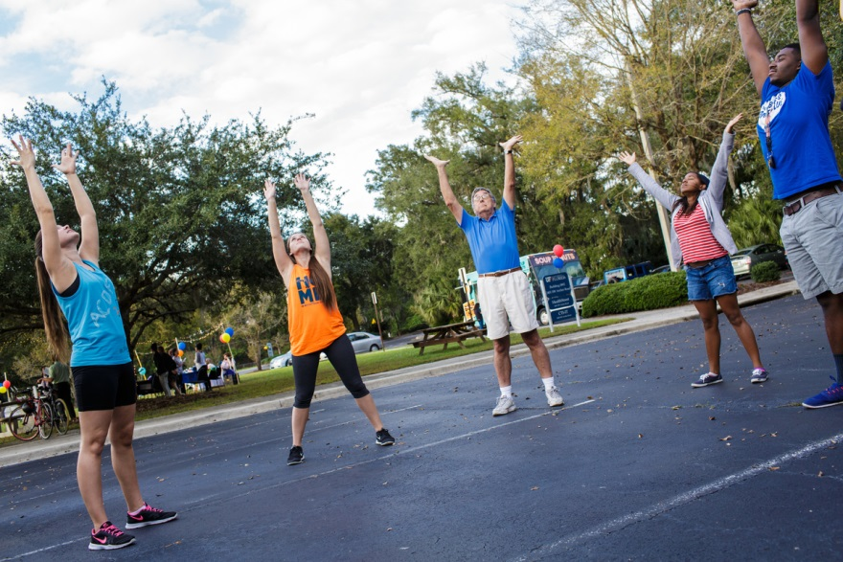
What is HealthStreet?
HealthStreet is an innovative community engagement program at the University of Florida with a mission to improve the health of our community by bridging gaps in health care and research.

Slide 5
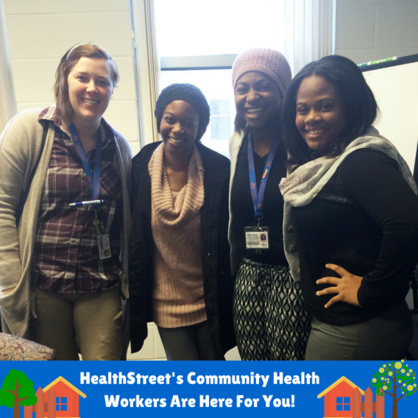
Assessment: It All Starts With Our Community Health Workers
Our Community Health Workers (CHW) are the foundation of the HealthStreet model.
CHWs assess health conditions, health concerns and research perceptions of community members.
They go out in the community where people live, work, and play, building meaningful connections.
Notes:
A lot of our work here at HST, happens out there

Slide 6
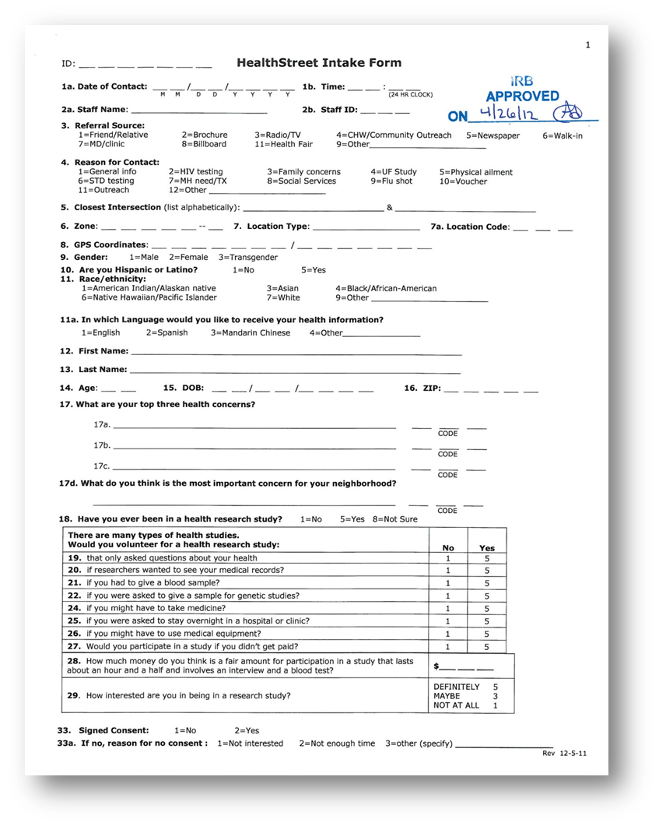
Notes:
Examples of the intake; it just shows that we go in-depth to understanding the needs of our community!

Slide 7
Top Health Concerns
Using the health assessment and what you’ve told us, we can address the health concerns and conditions of our community!
It gives us a great snapshot!
Notes:
Based on our over 7000 HSt members in North East Florida, they told us…

Slide 8
Services: HealthStreet Is Here for You!
Work every day to improve the health of our community.
Based on your personalized needs and concerns, HealthStreet links you to:
Medical and social services and
Opportunities to participate in research studies
Notes:
Also using this data, we can find ways to link people to social and medical services in our community.

Slide 9
Medical & Social Referrals
Child & Parenting Services
Academic & Education Services
Dental
Energy Assistance
Health Clinics
Housing
Exercise/Healthy Lifestyle
Notes:
Using our resource guide, we can refer community members to a variety of services offered in the community

Slide 10
Research Opportunities Based On Your Needs & Concerns
Examples of health research studies available:
Periodontal Disease in Children and Young Adults
The purpose of this study is to learn more about gum disease in children/young adults (ages 5-25) and improve quality of dental care for those with gum disease. Participants will be asked to complete oral examinations, and dental and medical questionnaires. Children will also receive free dental cleanings throughout duration of study.
Pediatric Sleep Study
The purpose of this research study is to figure out ways to help children who struggle with weight improve their sleep. Participation involves medical history questionnaires and a sleep interview.
Notes:
Here are examples of studies available currently for children! Based on your needs and concerns, there are studies possibly available for a variety of categories: lower back pain, memory, healthy eating, diabetes, COPD, dental and more!

Slide 11
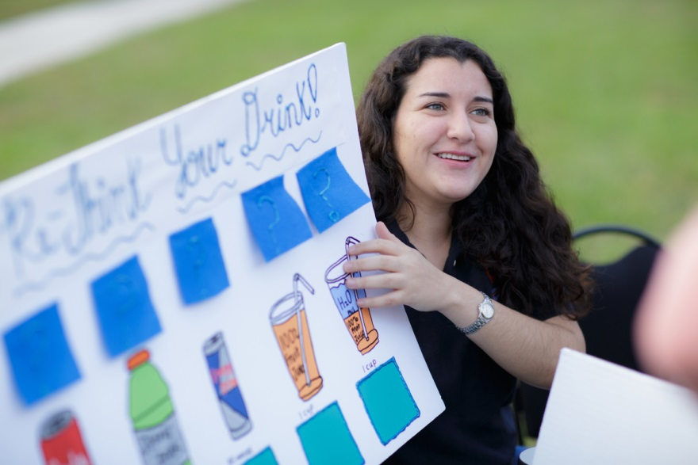
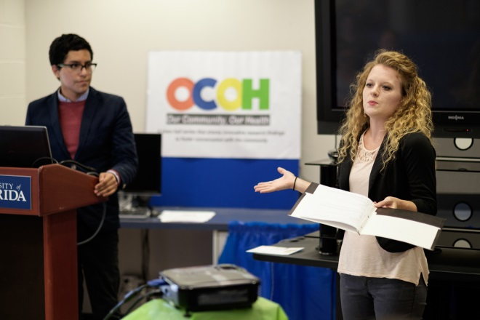
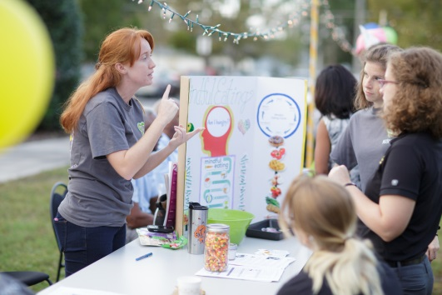
Education: Teaching Our Community To Be Healthier
Notes:
Through our partnerships with wonderful community organizations and UF programs, we provide free health education for our community members at the HealthStreet Facility.
We currently have dance fitness sessions through the Arts in Medicine available for all ages (We have flyers)
We also have Cooking Matters, a partnering class through the UF Family Nutrition orgram, where we teach people how to cook delicious, budget-friendly and nutritious meals for their families! (Our current session is full but we will start again in the summer!)
We also host health fairs, support groups for health topics like diabetes and cancer, in addition to town hall meetings for you to discuss health concerns you have! (OCOH)

Slide 12
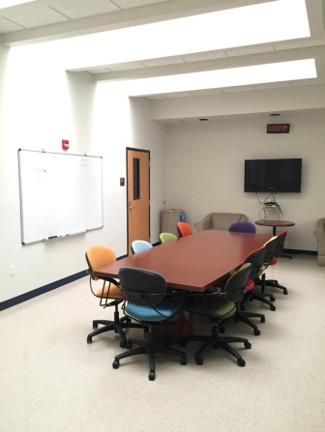
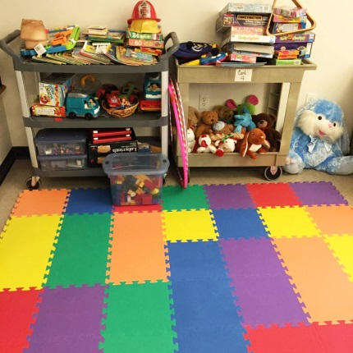
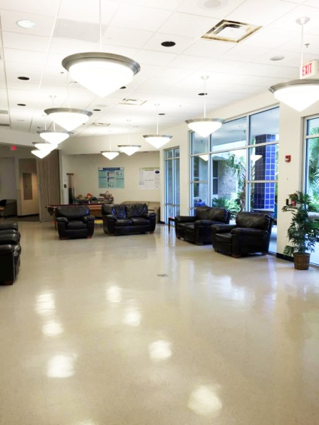
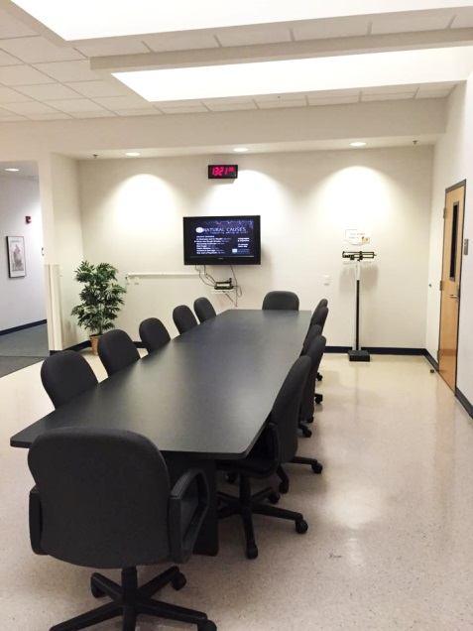
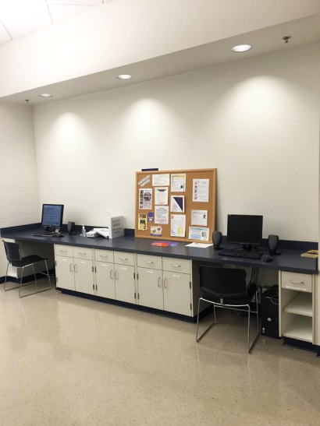
Our Facility
Notes:
Our facility is located on SW Archer Road, we host our services here in addition to the health education!

Slide 13
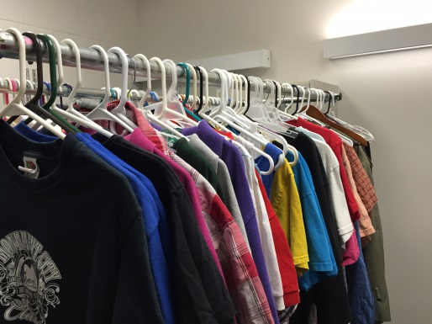
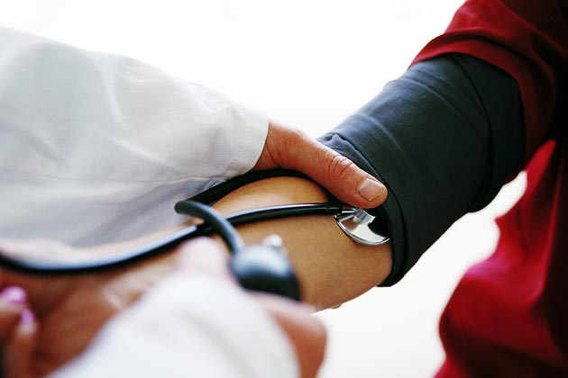
No Cost Services At HealthStreet
Blood Pressure Screenings
Confidential HIV testing and Counseling
Computer Usage and Tutorials
Eye Exams
Job Assistance
The Clothing Closet (Wednesday-Friday)
Toiletry and Dental Pantry (Wednesday-Friday)
Notes:
We also provide a variety of services at our facility to improve the health of our community member’s

Slide 14
Making An Impact
Ultimately improving the
health of the community.

Slide 15
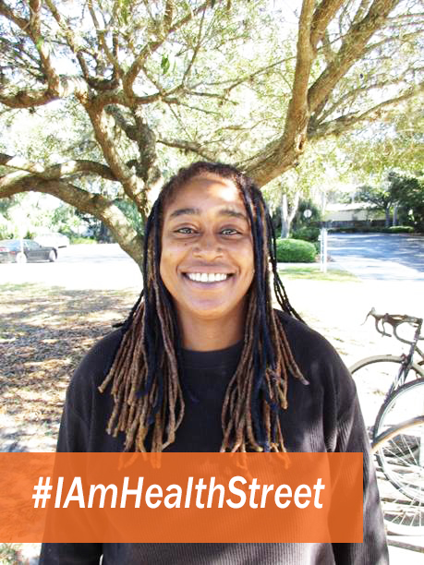
Meet Kenya!
A mother who has improved her and her family’s health through HealthStreet.
Uses the services at HealthStreet, or through our community partners, to continue improving her and her children’s livelihood.
Participated in a studies about:
healthier eating habits
monitoring blood pressure.
“I know you all have open arms and that you’ll help me out when I need you guys”
Notes:
*Change to Kenya Watson’s story
In 2011,
Kenya was living in an old broken down trailer by the Blueberry farm in Gainesville.
Department of Children and Families was called to intervene
One of our CHWs came with clothing, and other supplies to help build up their trailer.
Through HealthStreet: Kenya received vouchers to receive food for her family
She made a comment saying that if her sons knew she came to HealthStreet without them, they’d be mad
Studies:
-Blood Pressure Study –Taught her how to self-monitor her BP
Navigation Study-
Healthy Eating Study

Slide 16
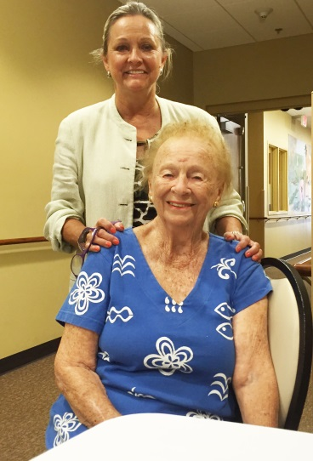
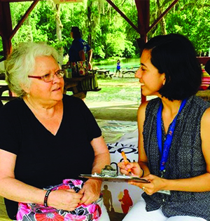
Now You Can Be Heard!
Become a HealthStreet member, there’s no cost!
Be informed and connected to research studies and services that are unique to your specific needs. Together we are making research more:
Representative
Approachable
Understandable
Personable
Notes:
Discuss how people can become a HealthStreet members after this presentation.

Slide 17
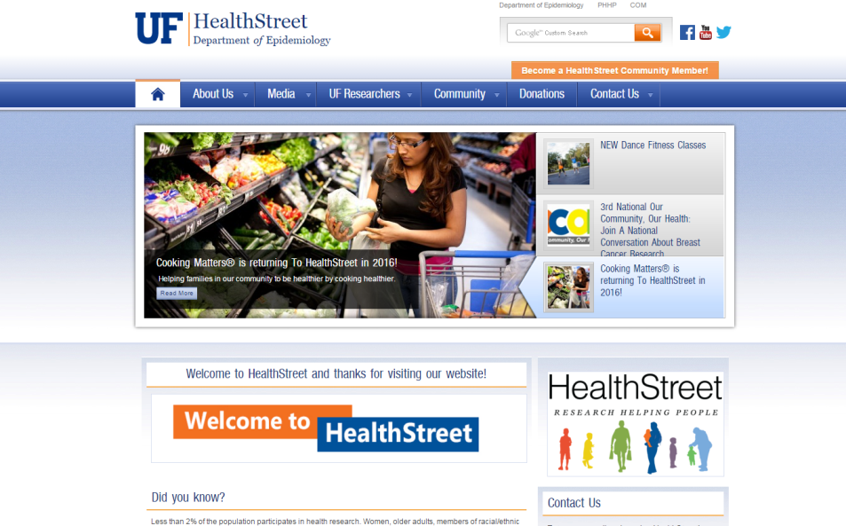
Contact Information
Visit our website at MyHealthStreet.org for more information about becoming a HealthStreet member, and information for events, groups, or classes we hold at our facility.
Join us on social media: @UFHealthStreet
Sign up For Our Newsletter
2401 SW Archer Road Gainesville, Fl (352) 294-4880
Notes:
Cheri’s portion of the presentation

Slide 18
Thank You!

