Slide 1
Osteoarthritis
AFCC Healthy Christian Wednesday

Slide 2
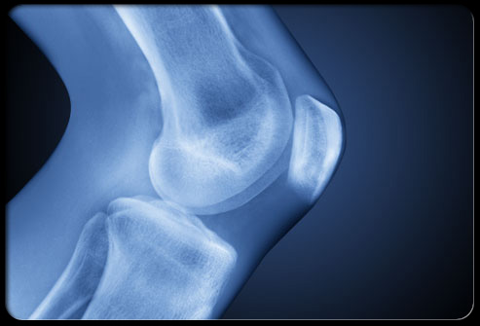
Osteoarthritis

Slide 3
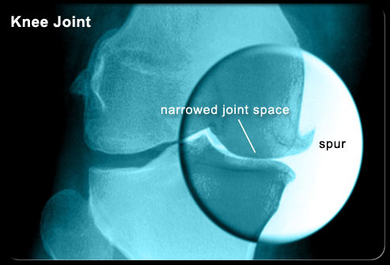
Osteoarthritis

Slide 4
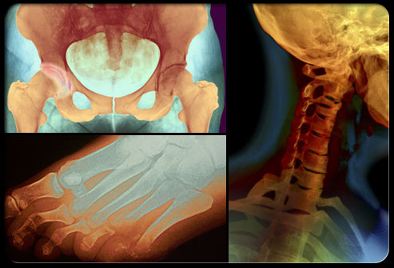
Osteoarthritis

Slide 5
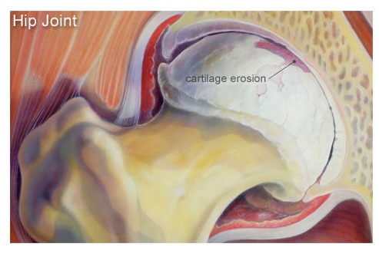
Degenerative joint disease

Slide 6
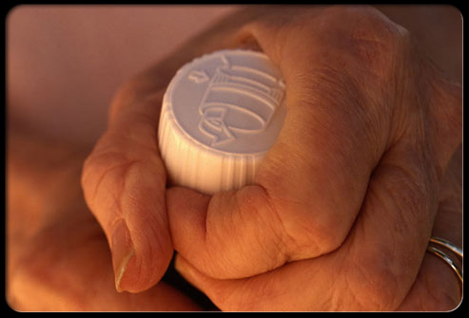
Risk factors:aging

Slide 7
Risk factor: trauma

Slide 8
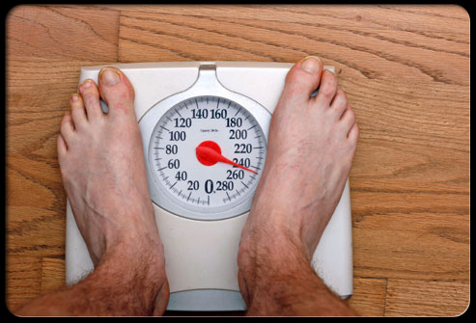
Risk factor: obesity

Slide 9
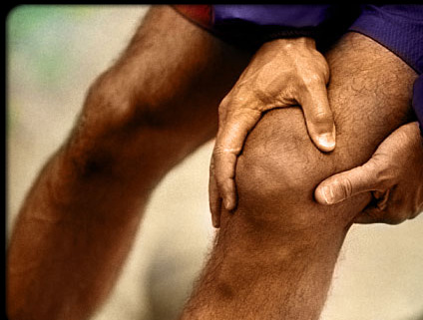
Symptoms

Slide 10
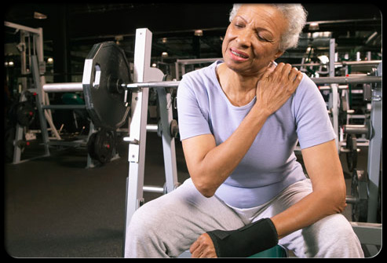
Symptoms

Slide 11
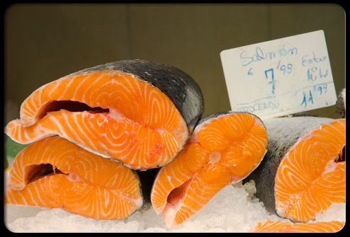
Anti-inflammatory diet

Slide 12
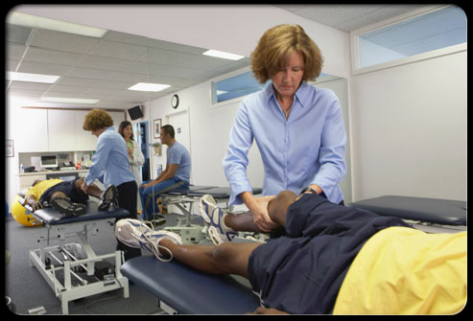
Physical therapy

Slide 13
Modalities

Slide 14
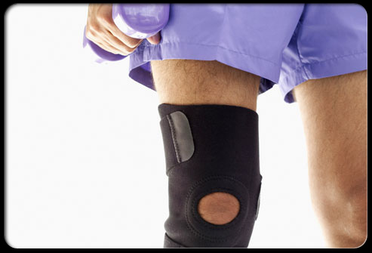
Bracing

Slide 15
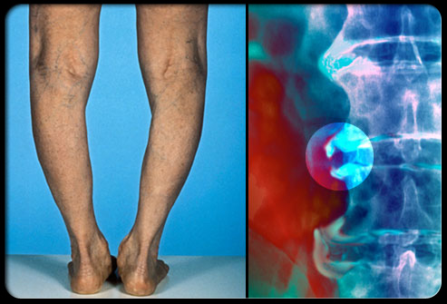
Long term effects

Slide 16
Anti-inflammatory diet

Slide 17
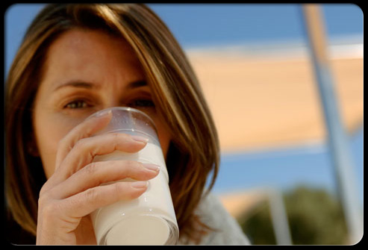

Slide 18
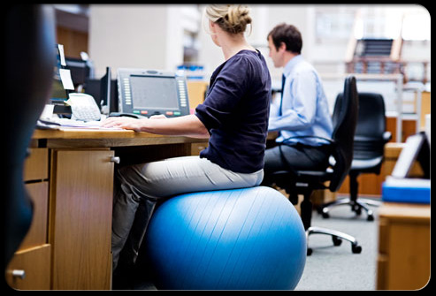
Proper posture

Slide 19
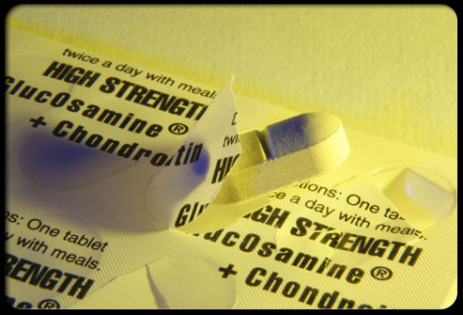
Supplements: glucosamine
Chondroitin sulfate

Slide 20
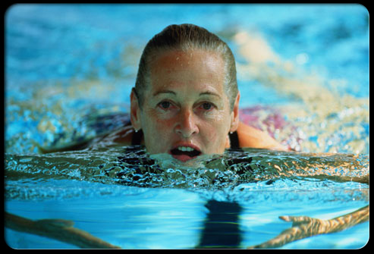
Aquatic exercises

Slide 21
Low impact exercises

Slide 22
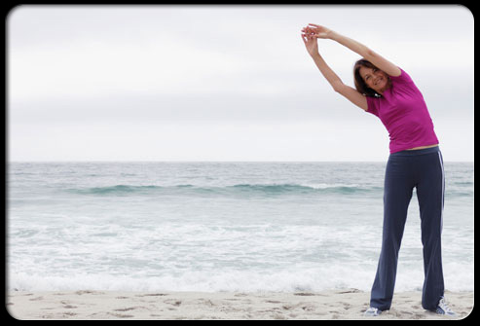
Prevention

Slide 23
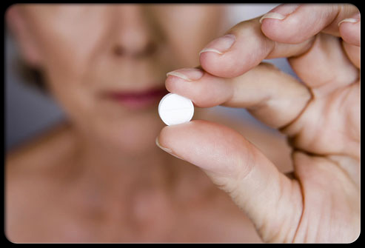
Meds: acetaminophen
Anti-inflammatories

Slide 24
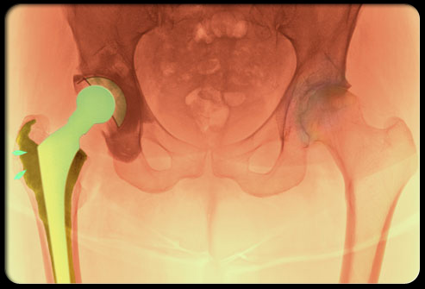
Surgical treatment

Slide 25
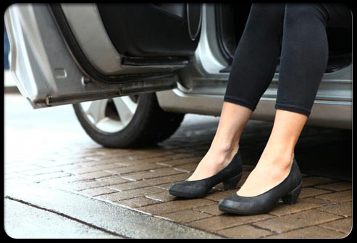
Living with arthritis

Slide 26
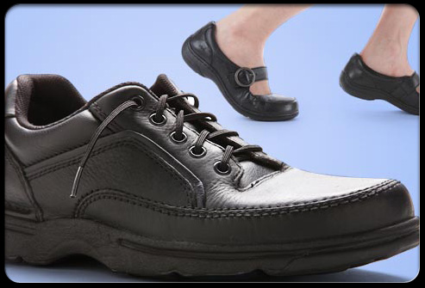
Living with arthritis

Slide 27
Living with arthritis:
Energy conservation techniques

Slide 28
Living with arthritis:
Energy conservation techniques

Slide 29
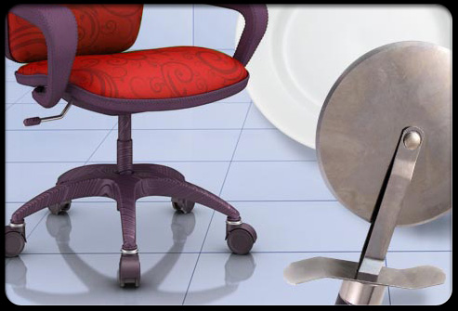
Living with arthritis

Slide 30
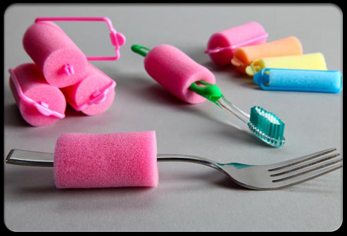
Living with arthritis:adapt

Slide 31
Living with arthritis

Slide 32
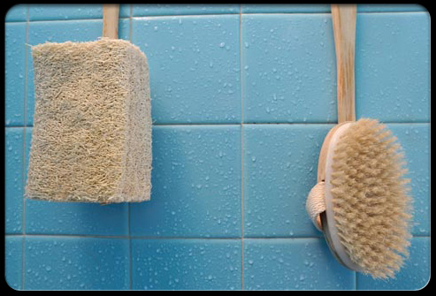
Living with arthritis:adapt

Slide 33
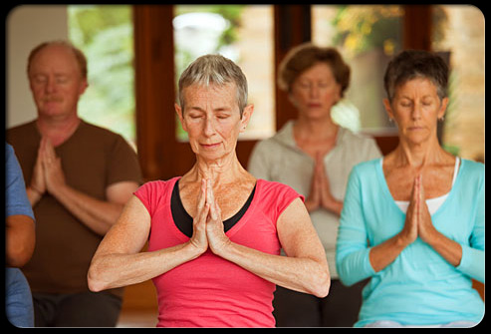
Yoga or tai chi

Slide 34
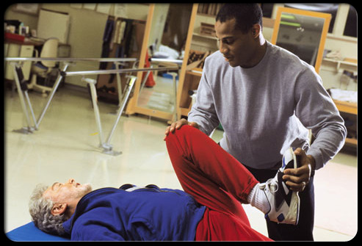
Therapeutic exercises:
Knee to chest

Slide 35
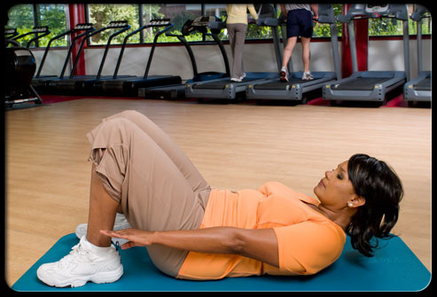
Therapeutic exercises:
Core strengthening

Slide 36
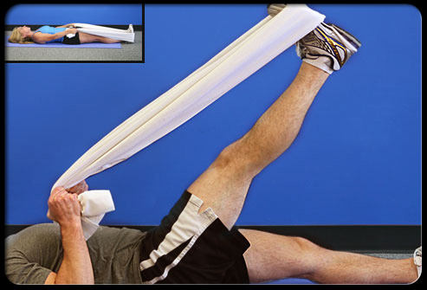
Therapeutic Exercises:
Hamstring stretch

Slide 37
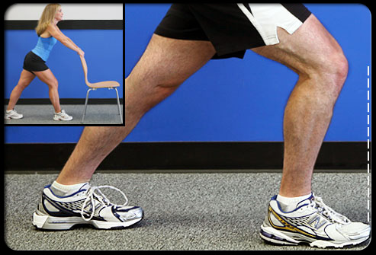
Therapeutic exercises:
Calf stretch

Slide 38
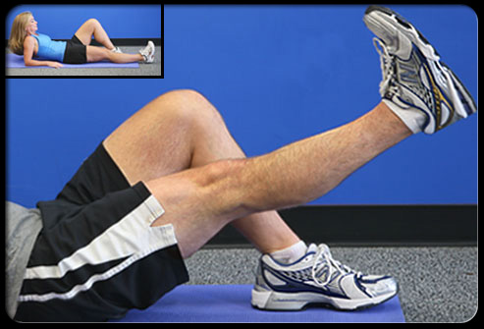
Therapeutic exercises:
Straight leg raise

Slide 39
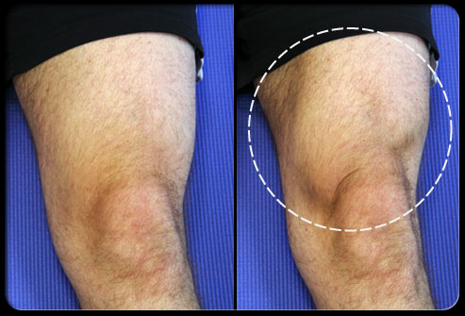
Therapeutic exercises:
Quad tightening

Slide 40
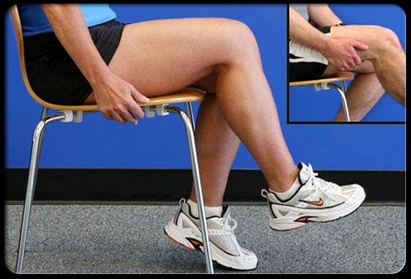
Therapeutic exercises:
Seated hip march

Slide 41
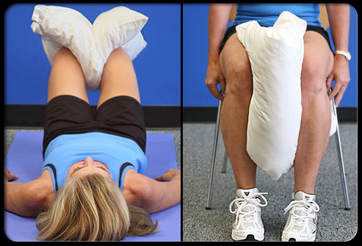
Therapeutic exercises:
Pillow squeeze

Slide 42
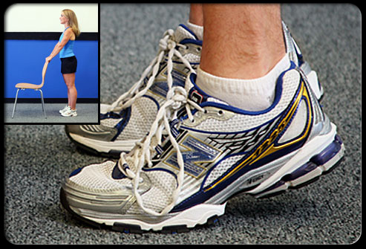
Therapeutic exercises:
Heel raises

Slide 43
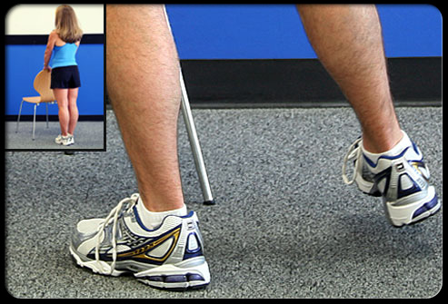
Therapeutic exercises:
Side leg raises

Slide 44
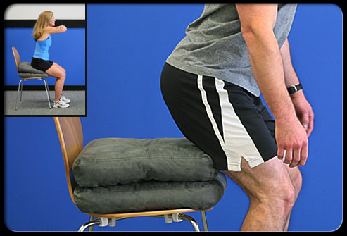
Therapeutic exercises:
Sit to stand

Slide 45
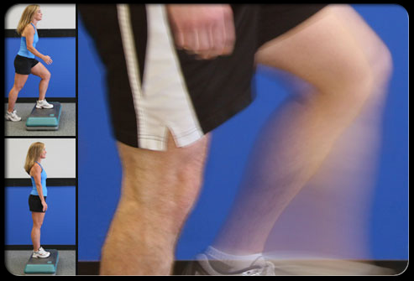
Therapeutic exercises:
Step-ups

