Slide 1
THE IMPACT OF COMMUNICATION ON RELATIONSHIPS
Self, Family, Friends

Slide 2
Be not deceived: evil communications corrupt good manners.
1 Corinthians 15:33

Slide 3
Communication: - the imparting or exchanging of information or news - the successful conveying or sharing of ideas and feeling

Slide 4
Corrupt: - cause to become morally depraved - infect; contaminate.

Slide 5
What we hear, see, and say communicates to our minds, hearts, and souls. Communication influences us.

Slide 6
Fast Pass

Slide 7
What’s the message?

Slide 8
Post to Be
If your dude come close to me He gon' want to ride off in a Ghost with me (I'll make him do it) I might let your boy chauffeur me But he got to eat the booty like groceries

Slide 9
Bad and Boujee
Raindrops, drop tops (drop top)
Smokin' on cookie in the hotbox (cookie)
F**kin' on your b***h she a thot, thot, thot (Thot)
Cookin' up dope in the crockpot, (pot)
We came from nothin' to somethin’ ni**a (hey)
I don't trust nobody, grip the trigger (nobody)
Call up the gang, they come and get you (gang)

Slide 10
Roll In Peace
You ain't the one for me, baby
You ain't got s**t I need, b***h
You want me to take my time with you
Well maybe I'm not your speed, b***h
Maybe I'm out your league, b***h
You ain't even got no cheese, b***h
Maybe I'm just too G for you
Or maybe I'm just too street, b***h

Slide 11
Nann
B***h you don't know nann ni**a, uh uh
Who do the s**t that I do
Run through yo whole lil' crew
Pay for it if I got to
H*e you don't know nann ni**a, uh uh
That'll run off in yo house
Put the gun off in yo mouth
Blow yo motherf***ing brains out
You don't know nann h*e, uh uh
Don' been the places I been
Who can spend the grands that I spend
F**k 'bout 5 or 6 best friends
You don't know nann h*e, uh uh
That sell more a** than me
You know nann h*e
That'll make you come like me

Slide 12
Knuck If You Buck
Yeah we knuckin' and buckin' and ready to fight
I betcha I'm'a throw dem thangs
So haters best to think twice
See me I ain't nothin nice
And crime mob it ain't no stoppin'
It be like Sadaam Husein, Hitler, and Osama Bin Laden
Now they steady gun poppin'
And I am actin' a fool
I wish a hater would get crunk up on this crime mob crew

Slide 13
Relationships

Slide 14
All relationships should be driven by purpose and love. Relationships should not be driven just by passion because it’s unstable. Passion is a feeling and feelings change.

Slide 15
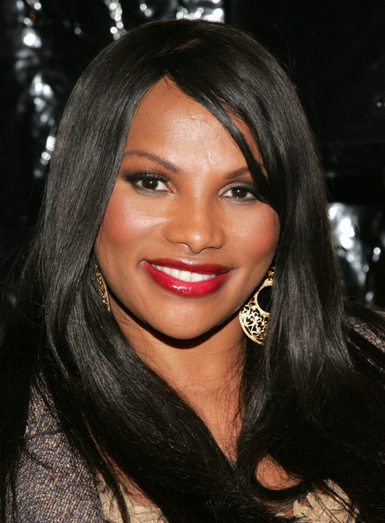
“I thought Will was really cute and we would hang out a lot on the road. He liked to take care of me and never let me spend a dime. He was that kind of guy, real generous. I remember when they won their first award, he asked me to go out with him afterward. He was so excited. We were walking along the street getting ready to grab something to eat, and he just gave this homeless guy $100 dollars…I sometimes kick myself when I think about what could have been. He was so nice to me, but I really wasn’t feeling him. I guess I couldn’t appreciate a nice guy like Will Smith. He wasn’t thug enough. I was attracted to thugs and hoodlums. Will was too nice to me.”
“I liked people like Louis Burrell (MC Hammer’s brother). He was rough, he was street and he didn’t pull any punches. He would walk around with a cane and pimp hat. He always referred to women as b**ches.” Even with all that, I liked him.”

