Slide 1
Thoughts & Intents of the Heart pt. 2
For the word of God is living and powerful, and sharper than any two-edged sword, piercing even to the division of soul and spirit, and of joints and marrow, and is a discerner of the thoughts and intents of the heart.
Heb. 4:12 (NKJV)

Slide 2
Thoughts & Intents of the Heart pt. 2
Swindoll writes: “How important is the heart? It is there that character is formed.
It alone holds the secrets of true success.
Its treasures are priceless—but they can be stolen.”

Slide 3
Thoughts & Intents of the Heart pt. 2
The Bible says very little about success, but as seen, it says a tremendous amount about the heart because the heart is the wellspring of true success.
The heart is one of the most commonly used terms of the Bible and, again, most of these occurrences are used metaphorically of the inner man, either of the mind, the emotions, the will, the sinful nature, or inclusively of the total inner person.

Slide 4
Thoughts & Intents of the Heart pt. 2
Do we naturally think about things as god thinks?
What can we do that can help us to be more like him?

Slide 5
Thoughts & Intents of the Heart pt. 2
We don’t naturally think and look at life like God does. His thoughts and ways are high above ours.
We desperately need the wisdom and direction of the Lord to know His ways and to know our own heart and its wicked ways. Proverbs 19:3 warns us that our foolishness subverts or perverts our way.
“Perverts” is the Hebrew word, salaph, “to twist, pervert, overturn.”
Principles are established standards of the heart & mind.
The data you process and put away in the brain can become the feeder (supplier/product) of your heart.

Slide 6
Thoughts & Intents of the Heart pt. 2
Watch your thoughts. They become words.
Watch your words. They become deeds.
Watch your deeds. They become habits.
Watch your habits. They become character.
Character is everything. (Frank Outlaw)

Slide 7
Thoughts & Intents of the Heart pt. 2
In other words
Before a person acts bad,
you can be sure they think & talk bad.
When they both talk and walk they are a spokesman in both word and deed.
they become a walkie/talkie! (it becomes their character) (prov. 6:12)

Slide 8
Thoughts & Intents of the Heart pt. 2
Sometimes it is hard to admit to sneaky, dishonest, crafty or manipulative intentions as a Christian.
The truth will set us free and help us to make wiser decisions.
Do not give yourself the means of carrying out your wrong intentions.
Deny the Heart/Thoughts what they need if they are to be implemented to do harm.

Slide 9
Thoughts & Intents of the Heart pt. 2
Intents of our heart can be a very complex part in our lives.
When something "looks like", "feels like" "smells like" or "sounds like" something else then a whole cascade of thoughts, memories and emotional reactions can be produced that can cause our intents (our ways/actions) to change.
Our inner life plans, vows, self-promises and deep desires can retain power and remain active even to a time later on in life,
When our heart wants something very much, we can easily find excuses to do what it wants.

Slide 10
Thoughts & Intents of the Heart pt. 2
Jonah & Nineveh- Jonah disliked and had no compassion for Nineveh Because it was the capital city of the one nation that continually made war and fought against the Jews. Though God knew Jonah’s heart/intent was not right, God still sent him to deliver the message to a people he didn’t like.
Jonah 1: 1-3 & 8; Jonah 3:1-2
Jonah 3:4-10 (the people of Nineveh’s intent)
Jonah 4:1-11 (Jonah’s intent)
The message is more important than the messenger. God is intentional. And we know that all things work together for good to them that love God, to them who are the called according to his purpose. Rom. 8:28

Slide 11
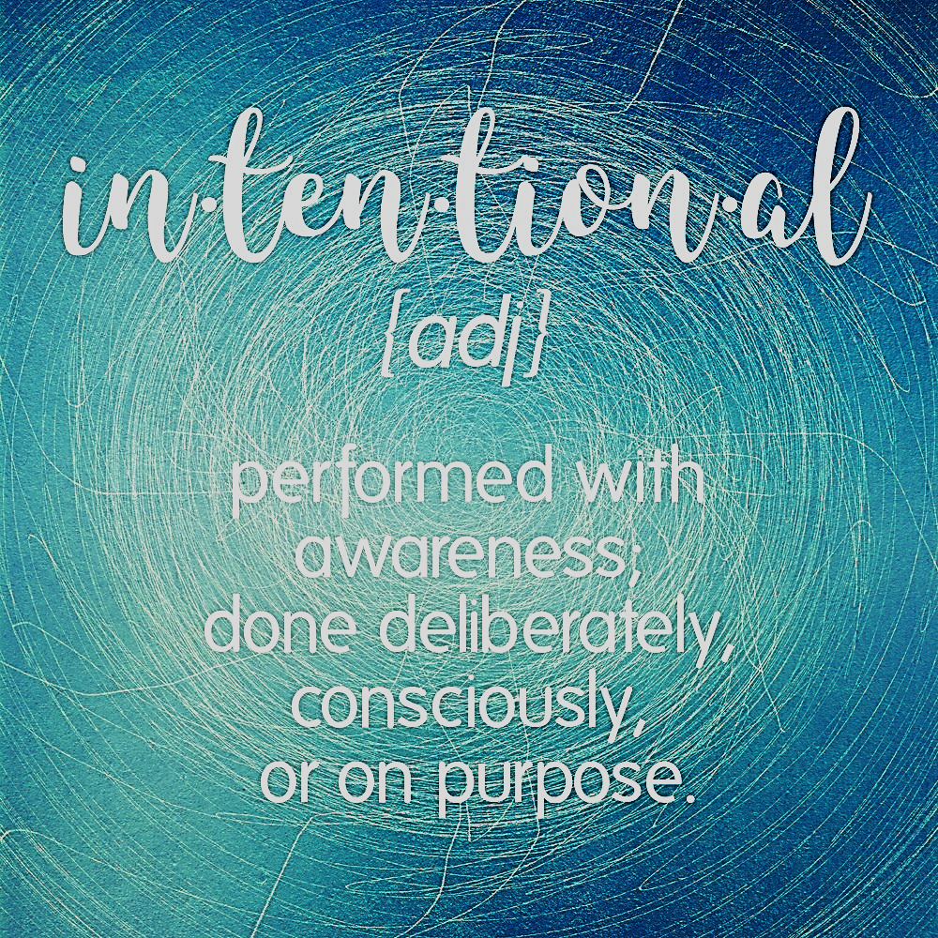
Thoughts & Intents of the Heart pt. 2

Slide 12
Thoughts & Intents of the Heart pt. 2
What do we need to do to guard our hearts or how do we keep our hearts pure?

Slide 13
Thoughts & Intents of the Heart pt. 2
We Want Our Hearts To Be Pure
Matt. 5: 8-Blessed are the pure in heart, for they shall see god.
The heart needs guarding because out of it flows the issues of life.
As is the fountain, so must be the streams that flow from it—the eyes, the mouth, the feet, i.e., words and actions.
From the abundance of the heart the mouth speaks.

Slide 14
Thoughts & Intents of the Heart pt. 2
Intentional living
Live life, then, with a due sense of responsibility (walk in the spirit), not as men who do not know the meaning and purpose of life but as those who do (you shall not fulfill the lust of the flesh). Make the best use of your time, despite all the difficulties of these days. Don’t be vague but firmly grasp what you know to be the will of God (Be led by the spirit of god). Eph. 5: 16-18

Slide 15
Thoughts & Intents of the Heart pt. 2
What helps us:
Heb. 4:12 (CJB)-See, the Word of God is alive! It is at work and is sharper than any double-edged sword - it cuts right through to where soul meets spirit and joints meet marrow, and it is quick to judge the inner reflections and attitudes of the heart. (Complete Jewish Bible)
Heb. 4:12 (NLT)-For the word of God is full of living power. It is sharper than the sharpest knife, cutting deep into our innermost thoughts and desires. It exposes us for what we really are.

Slide 16
Thoughts & Intents of the Heart pt. 2
As Christians we have to take time and effort to make sure their inner personal beliefs line up with God's Word.
With God’s help & His Word we CAN interpret reality properly and pay attention to our heart.
Your promises to yourself are not as important as Christian obedience and the promises of God.
If you are looking for a fight you can usually find one or start one.
Don’t get stuck in your own way or your own intent may override the things of God.

Slide 17
Thoughts & Intents of the Heart pt. 2
Since the heart is so important to what we think, say, and do, we each need to regularly do open heart surgery with the scalpel of the Word under the guiding hand of the great physician, the Lord Jesus.
We accomplish this through the teaching, guiding, convicting ministry of the Holy Spirit & the word of god.
Be accountable to what you allow to enter your heart through media, gossip, jealousy, hate, anger, unforgiveness, bitterness, hurt etc.
Read God’s word and allow Him to cleanse you of your old ways.

Slide 18
Thoughts & Intents of the Heart pt. 2
Guard The thoughts and intents of the Heart
Out of the abundance of the heart the mouth speaks and responds by using our skills for good or evil (Matt. 12:34).
There is a way that may seems right to us that can cause us to wander from God in our hearts (Isa. 53:6a).
We want to be in control , direct our own affairs and live independently.
We want to be in charge of our own destinies. Oh yes, some of us want to trust God with getting us into heaven, but we would too often prefer to direct our own affairs down here on earth partly because we are so committed to our own desires.
To completely follow Gods directions may mean giving up something that we think we must have in order to be secure or happy.

Slide 19
Bible Study TBA

Slide 20
References:
Bible.knowing/jesus.com
The Thoughts and Intentions of the Heart (Globalchristians.org)
Guarding The Heart, bible.org

