Slide 1
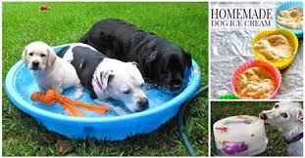
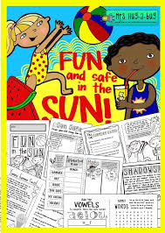
AFCC Healthy Christian Ministry
Safety Presentation
5/27/15

Slide 2
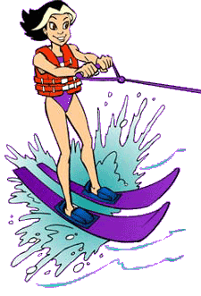
H20 SMARTZ: DO’S & DON’T
DO learn to swim.
DO take a friend along
DO know your limits.
DO swim in supervised (watched) areas only.
DO wear a life jacket when boating.

Slide 3
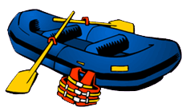
H20 SMARTZ: DO’S & DON’T
DO stay alert to currents.
DO keep an eye on the weather
DON'T mess around in the water.
DON'T dive into shallow water.
DON'T float where you can't swim.

Slide 4
Recreational Water Illnesses
(RWI’s):
gastrointestinal
skin
ear
respiratory
eye
neurologic
wound infections
The most commonly reported RWI is diarrhea.
Notes:
Contrary to popular belief, chlorine does not kill all germs instantly. There are germs today that are very tolerant to chlorine and were not known to cause human disease until recently. Once these germs get in the pool, it can take anywhere from minutes to days for chlorine to kill them. Swallowing just a little water that contains these germs can make you sick.
Recreational water illnesses (RWIs) are caused by germs spread by swallowing, breathing in mists or aerosols of, or having contact with contaminated water in swimming pools, hot tubs, water parks, water play areas, interactive fountains, lakes, rivers, or oceans.

Slide 5
Prevention
Keep the pee, poop, sweat, and dirt out of the water!
Stay out of the water if you have diarrhea.
Shower before you get in the water.
Don’t pee or poop in the water.
Don’t swallow the water.
Every hour—everyone out!
Take kids on bathroom breaks.
Check diapers, and change them in a bathroom or diaper-changing area–not poolside–to keep germs away from the pool.
Reapply sunscreen.
Drink plenty of fluids.
Notes:
Check the free chlorine level and pH before getting into the water.
Pools: Proper free chlorine level (1–3 mg/L or parts per million [ppm]) and pH (7.2–7.8) maximize germ-killing power.
Hot tubs/spas: Proper disinfectant level (chlorine [2–4 parts per million or ppm] or bromine [4–6 ppm] and pH [7.2–7.8]) maximize germ-killing power.
Most superstores, hardware stores, and pool-supply stores sell pool test strips.

Slide 6
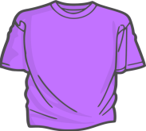
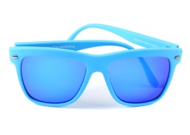
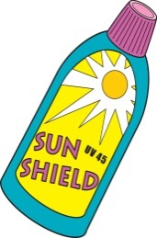
Sun Safety
Seek shade.
Cover up.
Get a hat.
Wear sunglasses.
Apply sunscreen.
Notes:
-UV rays are strongest and most harmful during midday, so it’s best to plan indoor activities then. If this is not possible, seek shade under a tree, an umbrella, or a pop-up tent. Use these options to prevent sunburn, not to seek relief after it’s happened.
-When possible, long-sleeved shirts and long pants and skirts can provide protection from UV rays. Clothes made from tightly woven fabric offer the best protection. A wet T-shirt offers much less UV protection than a dry one, and darker colors may offer more protection than lighter colors. Some clothing certified under international standards comes with information on its ultraviolet protection factor.
-Hats that shade the face, scalp, ears, and neck are easy to use and give great protection. Baseball caps are popular among kids, but they don’t protect their ears and neck. If your child chooses a cap, be sure to protect exposed areas with sunscreen.
-They protect your child’s eyes from UV rays, which can lead to cataracts later in life. Look for sunglasses that wrap around and block as close to 100% of both UVA and UVB rays as possible.
Use sunscreen with at least SPF 15 and UVA and UVB protection every time your child goes outside. For the best protection, apply sunscreen generously 30 minutes before going outdoors. Don’t forget to protect ears, noses, lips, and the tops of feet.

Slide 7
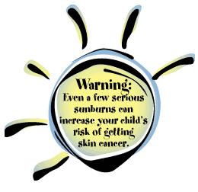
TOO MUCH HURTS
Turning pink/red
Tan
Cool and cloudy
Notes:
Unprotected skin can be damaged by the sun’s UV rays in as little as 15 minutes. Yet it can take up to 12 hours for skin to show the full effect of sun exposure. So, if your child’s skin looks “a little pink” today, it may be burned tomorrow morning. To prevent further burning, get your child out of the sun.
There’s no other way to say it—tanned skin is damaged skin. Any change in the color of your child’s skin after time outside—whether sunburn or suntan—indicates damage from UV rays.
Children still need protection. UV rays, not the temperature, do the damage. Clouds do not block UV rays, they filter them—and sometimes only slightly.
Oops! Kids often get sunburned when they are outdoors unprotected for longer than expected. Remember to plan ahead, and keep sun protection handy—in your car, bag, or child’s backpack

Slide 8
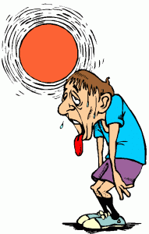
Warning signs of HEAT related illnesses
Heat Exhaustion Heavy sweating Weakness Cold, pale, and clammy skin Fast, weak pulse Nausea or vomiting Fainting | What You Should Do: Move to a cooler location. Lie down and loosen your clothing. Apply cool, wet cloths to as much of your body as possible. Sip water. If you have vomited and it continues, seek medical attention immediately.
Heat Stroke High body temperature (above 103°F)* Hot, red, dry or moist skin Rapid and strong pulse Possible unconsciousness | What You Should Do: Call 911 immediately — this is a medical emergency. Move the person to a cooler environment. Reduce the person's body temperature with cool cloths or even a bath. Do NOT give fluids.

Slide 9
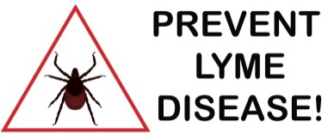
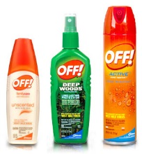
Insect and Tick Safety
Use an effective insect repellent while playing outdoors.
Make your backyard a tick-safe zone.
Check yourself, your children and Pets for ticks.
Notes:
CDC recommends a variety of effective products. Check the label for one of the following active ingredients:
- DEET
- Picaridin
- IR 3535
- Oil of lemon eucalyptus
-
Keep patios, play areas, and playground equipment away from shrubs, bushes, and other vegetation. Also, tick control chemicals are available for use by homeowners, or can be applied by a professional pest control expert.
-
check themselves and their children for ticks under the arms, in and around the ears, inside the belly button, behind the knees, between the legs, around the waist and especially in the hair.

Slide 10
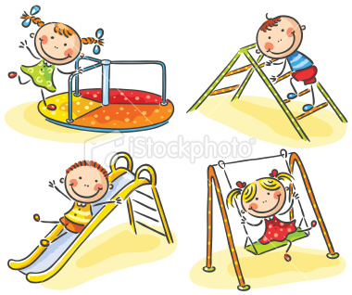
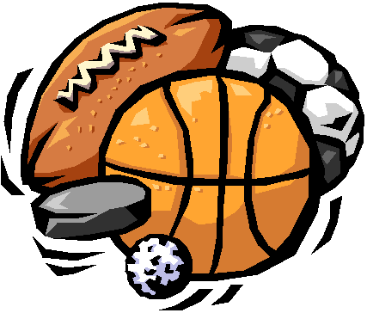
Injury Prevention
Play safely.
Make your home safer.
Keep sports safe.
Supervision is key.
Notes:
-Falls on the playground are a common cause of injury. Check to make sure that the surfaces under playground equipment are safe, soft, and well- maintained (such as wood chips or sand, not dirt or grass).
Use home safety devices, such as guards on windows that are above ground level, stair gates, and guard rails. These devices can help keep a busy, active child from taking a dangerous tumble.
-Make sure your child wears protective gear during sports and recreation. For example, when in-line skating, use wrist guards, knee and elbow pads, and a helmet
Supervise young children at all times around fall hazards, such as stairs and playground equipment, whether you’re at home or out to play.
-

Slide 11
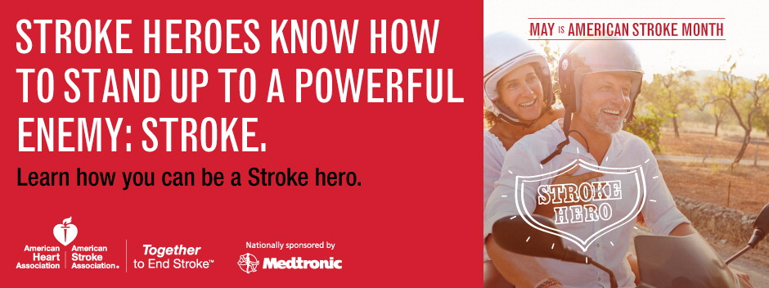
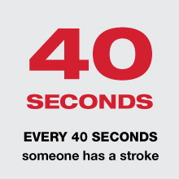
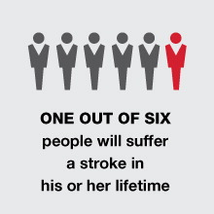
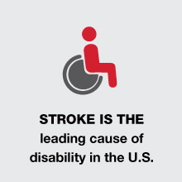
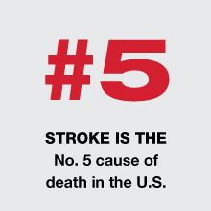
Notes:
Despite the tremendous toll stroke takes, the vast majority of Americans do not think of stroke as a major health concern. And one in three Americans is unable to identify all the F.A.S.T. stroke warning signs.
We need to make more people aware that stroke threatens millions of American lives, young and old, male and female, from every background. At the same time, stroke is largely preventable, treatable and beatable.
American Stroke Month is an annual opportunity to get the word out. Each May, the American Heart Association/American Stroke Association recognizes American Stroke Month by rallying the nation around the cause because together we can end stroke.

Slide 12
Stroke Risk Factors
Risk Factor that can NOT be changed:
Age
Heredity
Sex
Race
Prior history of stroke (TIA)
Notes:
Age — The chance of having a stroke approximately doubles for each decade of life after age 55. While stroke is common among the elderly, a lot of people under 65 also have strokes.
Heredity (family history) — Your stroke risk may be greater if a parent, grandparent, sister or brother has had a stroke. Some strokes may be symptoms of genetic disorders like CADASIL (Cerebral Autosomal Dominant Arteriopathy with Sub-cortical Infarcts and Leukoencephalopathy), which is caused by a gene mutation that leads to damage of blood vessel walls in the brain, blocking blood flow. Most individuals with CADASIL have a family history of the disorder — each child of a CADASIL parent has a 50% chance of inheriting the disease. Visit the NINDS website (opens in new window) or read the AHA/ASA scientific statement (opens in new window) on this topic for more details about CADASIL.
Race — African-Americans (opens in new window) have a much higher risk of death from a stroke than Caucasians do. This is partly because blacks have higher risks of high blood pressure, diabetes and obesity.
Sex (gender) — Each year, women have more strokes than men, and stroke kills more women than men. Use of birth control pills, pregnancy, history of preeclampsia/eclampsia or gestational diabetes, oral contraceptive use, and smoking, and post-menopausal hormone therapy may pose special stroke risks for women. Be sure to discuss your specific risks with your doctor.
Prior stroke, TIA or heart attack — The risk of stroke for someone who has already had one is many times that of a person who has not. Transient ischemic attacks (TIAs) are "warning strokes" that produce stroke-like symptoms but no lasting damage. TIAs are strong predictors of stroke. A person who's had one or more TIAs is almost 10 times more likely to have a stroke than someone of the same age and sex who hasn't. Recognizing and treating TIAs can reduce your risk of a major stroke. TIA should be considered a medical emergency and followed up immediately with a healthcare professional. If you've had a heart attack, you're at higher risk of having a stroke, too.

Slide 13
Stroke Risk Factors
Risk Factors that CAN be changed, treated or controlled:
High blood pressure
Cigarette smoking
Diabetes mellitus
High blood cholesterol
Poor diet
Physical inactivity and obesity
Notes:
High blood pressure — High blood pressure is the leading cause of stroke and the most important controllable risk factor for stroke. Many people believe the effective treatment of high blood pressure is a key reason for the accelerated decline in the death rates for stroke.
Cigarette smoking — In recent years, studies have shown cigarette smoking to be an important risk factor for stroke. The nicotine and carbon monoxide in cigarette smoke damage the cardiovascular system in many ways. The use of oral contraceptives combined with cigarette smoking greatly increases stroke risk.
Diabetes mellitus — Diabetes is an independent risk factor for stroke. Many people with diabetes also have high blood pressure, high blood cholesterol and are overweight. This increases their risk even more. While diabetes is treatable, the presence of the disease still increases your risk of stroke.
High blood cholesterol — People with high blood cholesterol have an increased risk for stroke. Also, it appears that low HDL (“good”) cholesterol is a risk factor for stroke in men, but more data are needed to verify its effect in women.
Poor diet — Diets high in saturated fat, trans fat and cholesterol can raise blood cholesterol levels. Diets high in sodium (salt) can contribute to increased blood pressure. Diets with excess calories can contribute to obesity. Also, a diet containing five or more servings of fruits and vegetables per day may reduce the risk of stroke (PDF opens in new window).
Physical inactivity and obesity — Being inactive, obese or both can increase your risk of high blood pressure, high blood cholesterol, diabetes, heart disease and stroke. So go on a brisk walk, take the stairs, and do whatever you can to make your life more active. Try to get a total of at least 30 minutes of activity on most or all days.
Others:
Carotid or other artery disease
Peripheral artery
Atrial fibrillation
Sickle cell disease

Slide 14
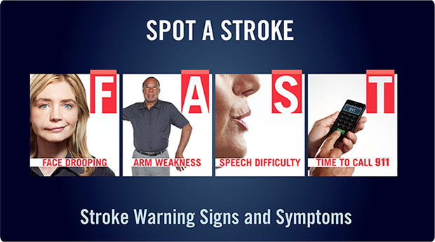
Notes:
F- Does one side of the face droop or is it numb? Ask the person to smile. Is the person's smile uneven?
A-Is one arm weak or numb? Ask the person to raise both arms. Does one arm drift downward?
S-Is speech slurred? Is the person unable to speak or hard to understand? Ask the person to repeat a simple sentence, like "The sky is blue." Is the sentence repeated correctly?
T-If someone shows any of these symptoms, even if the symptoms go away, call 9-1-1 and get the person to the hospital immediately. Check the time so you'll know when the first symptoms appeared.
There is a 3 hour window (4.5 in certain eligible patients) to receive TPA(tissue plasminogen activator) which will increase the chances of recovering from a stroke.
Beyond F.A.S.T. – Other Symptoms You Should Know
Sudden numbness or weakness of the leg, arm or face
Sudden confusion or trouble understanding Sudden trouble seeing in one or both eyes Sudden trouble walking, dizziness, loss of balance or coordination Sudden severe headache with no known cause

Slide 15
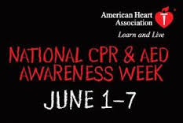

Slide 16
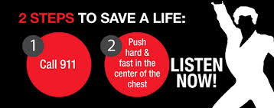
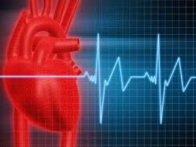

Slide 17
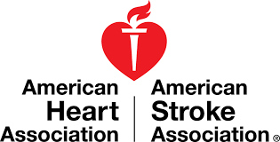
The End

